Slide 1
Office of the Montgomery County Engineer

Slide 2
MOT-SHOUP MILL-14.66 SHOUP MILL ROAD IMPROVEMENT PID 110332, JOB NO. 2018-20

Slide 3
PROJECT LOCATION
N
STILLWATER RIVER
CONSTRUCTION LIMITS
SINCLAIR PARK
SHOUP MILL ROAD
SUE ANN BLVD.
RIVERSIDE DRIVE
SR 48

Slide 4
PROJECT CORRIDOR

Slide 5
PROJECT CORRIDOR

Slide 6
PROJECT CORRIDOR

Slide 7
PROJECT CORRIDOR

Slide 8
PROJECT CORRIDOR

Slide 9
PROJECT CORRIDOR

Slide 10
PROJECT CORRIDOR

Slide 11
PROJECT CORRIDOR

Slide 12
SCOPE OF PROJECT
Replace deteriorated asphalt wearing surface and make repairs to underlying concrete pavement.
Replace crumbling concrete medians
Replace deficient storm sewer catch basins and pipes
Replace existing traffic signal at Riverside Dr. & Shoup Mill Dr. Intersection
Replace structurally deficient bridge and culvert
Rehabilitate structurally deficient bridge
Install sidewalk and shared-use path

Slide 13
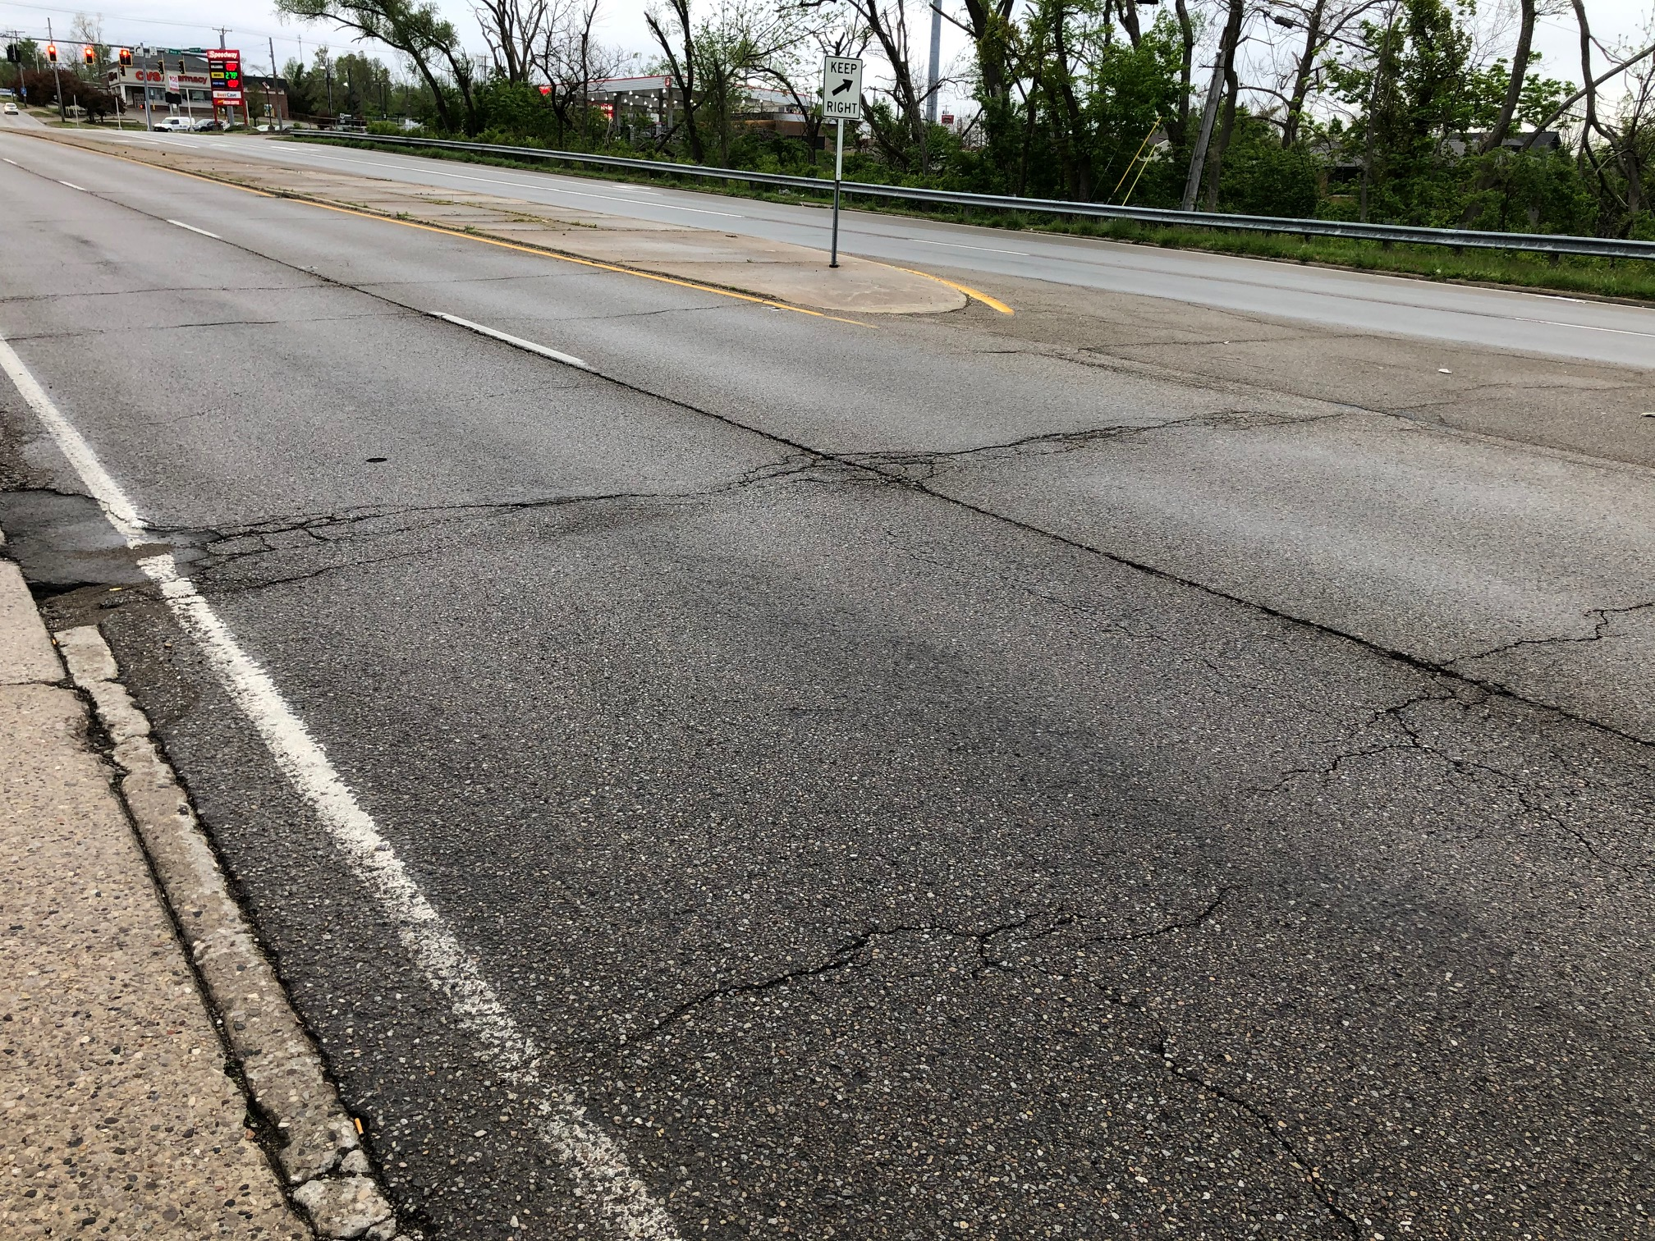
EXISTING CONDITIONS – Pavement
Right: Typical condition of asphalt wearing surface over concrete pavement. Note rutting (waves) in asphalt wearing surface.
Below: Note raised transverse cracks in asphalt at concrete pavement joint failures

Slide 14
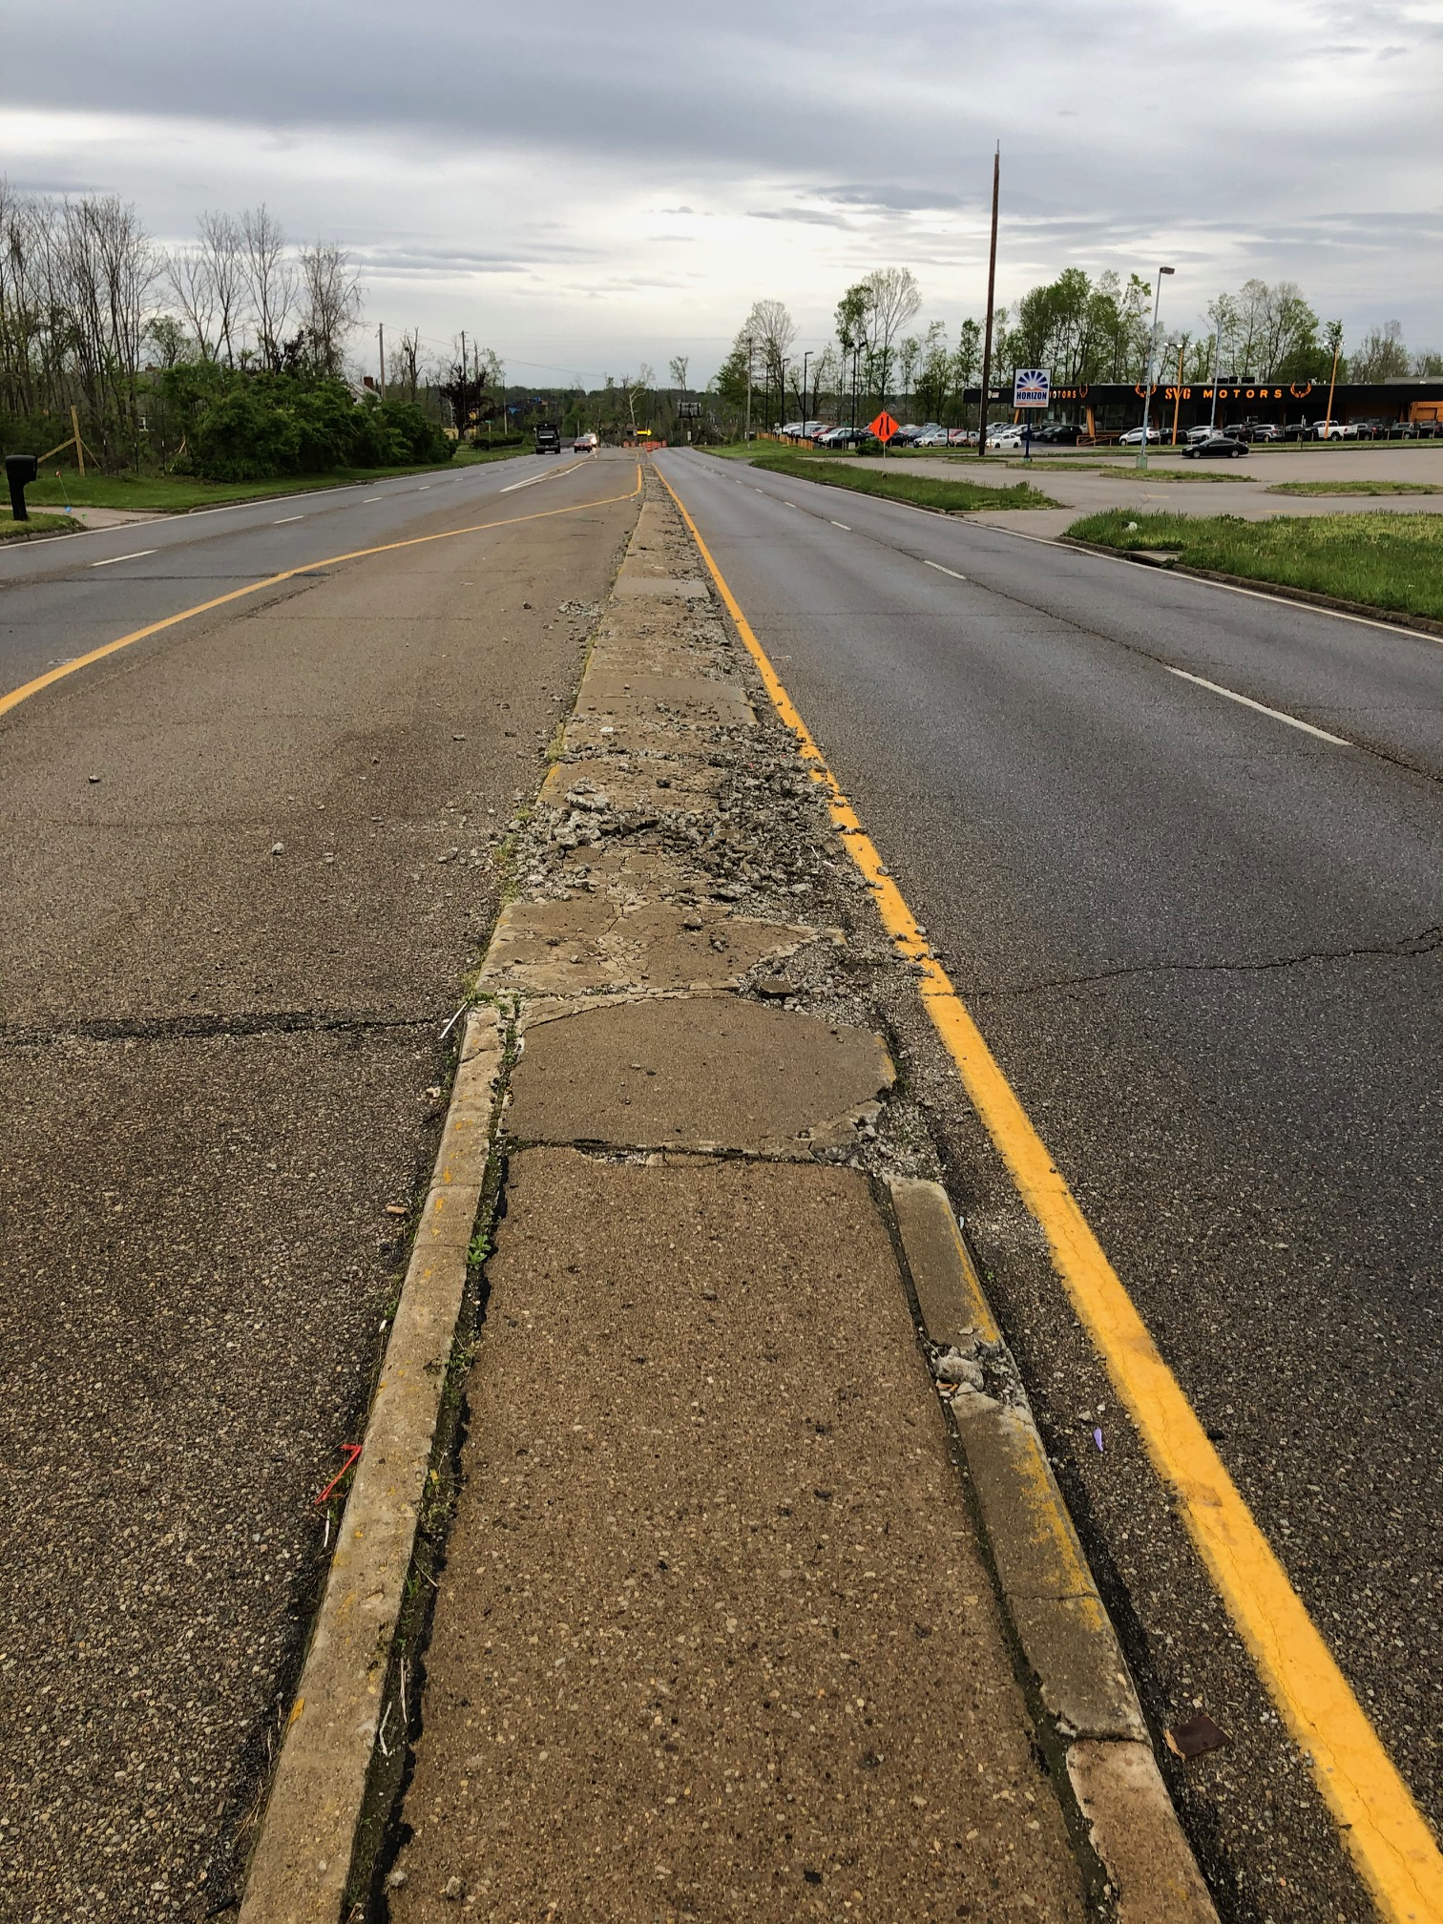
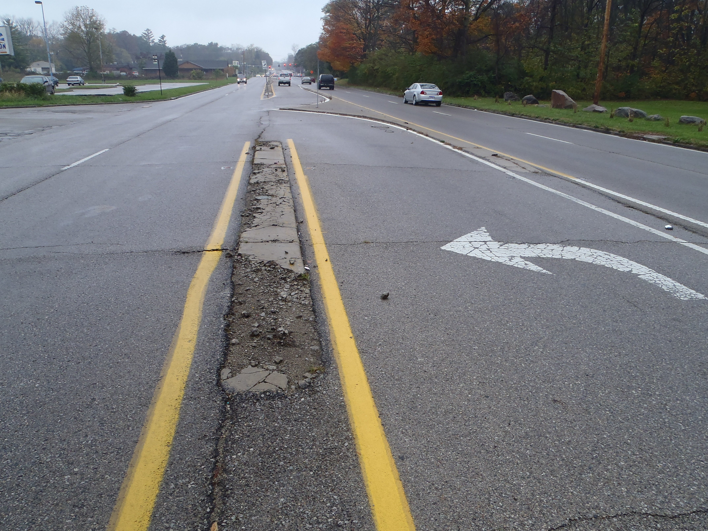
EXISTING CONDITIONS – Medians
Replace existing crumbling medians
Pictures shows typical condition of medians along Shoup Mill Road.

Slide 15
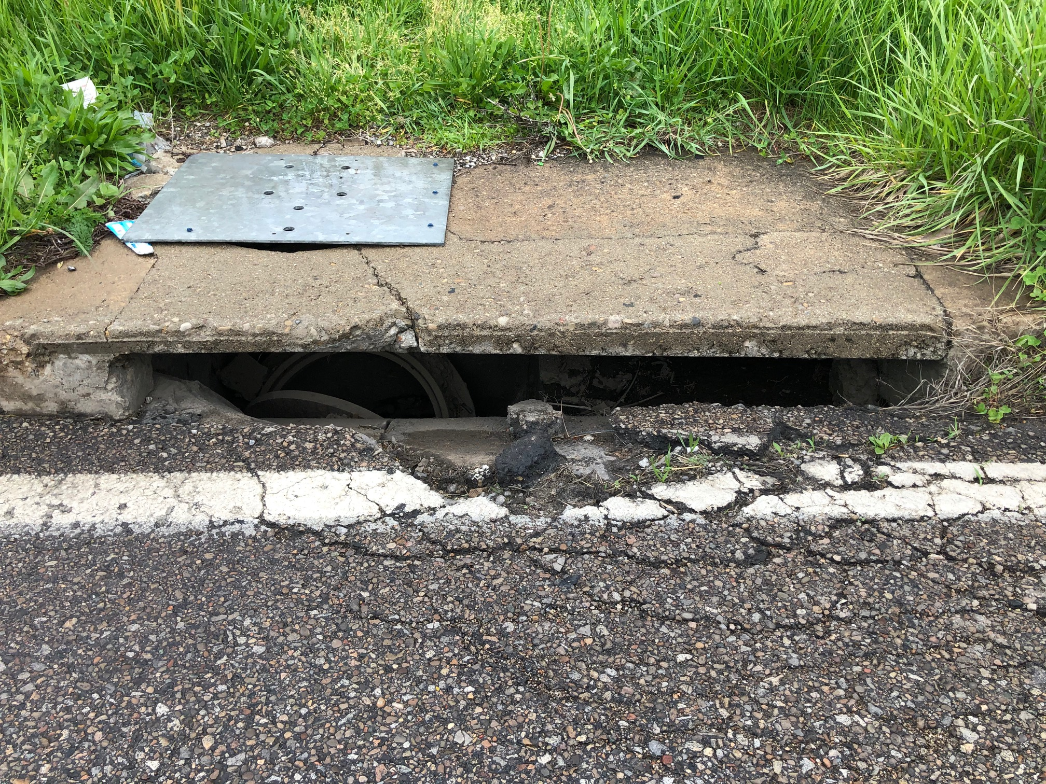
EXISTING CONDITIONS – Storm Sewer
Pictures show typical condition of catch basins along Shoup Mill Road.

Slide 16
EXISTING CONDITIONS – Traffic Signal
Picture of existing span wire traffic signal at the intersection of Riverside Drive and Shoup Mill Road

Slide 17
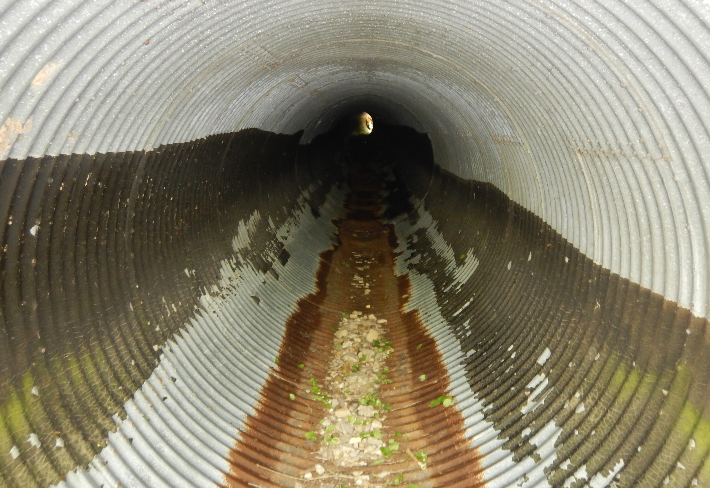
EXISTING CONDITIONS – Bridge & Culvert
Picture existing culvert 200 feet west of the intersection of Riverside Drive and Shoup Mill Road.
Structurally deficient culvert with a general appraisal rating of 4 out of 9. The general appraisal is a numerical value that represents a structures overall condition.

Slide 18
EXISTING CONDITIONS – Bridge & Culvert
Picture existing bridge under the intersection of Riverside Drive and Shoup Mill Road.
Structurally deficient bridge with a general condition rating of 4 out of 9

Slide 19
EXISTING CONDITIONS – Bridge & Culvert
Picture existing bridge immediately adjacent to the SR 48 & Shoup Mill Road intersection.
Structurally deficient bridge with a general condition rating of 2 out of 9

Slide 20
EXISTING CONDITIONS – Pedestrian & Bike Facilities
Picture to the right: Existing RTA stop with no adjacent pedestrian or shared-use path facility. Said stop is located adjacent to Horizon Science Academy.

Slide 21
PROPOSED RIGHT-OF-WAY
Warranty Deed = 0.3182 Acres Standard Highway Easement = 0.5983 Acres
Storm or Sanitary Sewer Easement = 0.0328 Acres Temporary Easement = 0.7822 Acres

Slide 22
PROJECT COSTS AND FUNDING
Design Engineering $666,640
Construction $4,290,000
Cost of easements to be determined by real estate appraisals
Federal Grant through MVRPC will cover $2,693,404 eligible project costs.
Will pursue Ohio Public Works Commission funding.

Slide 23
PROJECT SCHEDULE
Right-of-Way Acquisition September 2022 – August 2023
Utility Relocation September 2022 – March 2024
Construction March 2024 – May 2025

Slide 24
Detour Routes
Traffic will be maintained on Shoup Mill Road and Sue Ann Blvd during the project

Slide 25
QUESTIONS?

