Slide 1
Office of the Montgomery County Engineer

Slide 2
2023 ADA RAMP IMPROVEMENT PROGRAM

Slide 3
Aerial View
NORTH
STROOP ROAD
OWENDALE DR.
I-75
LAMME ROAD
PROJECT LIMITS
SR-741
RULLA CT.
ALEX-BELL ROAD

Slide 4
ADA TRANSITION PLAN 2020 SELF EVALUATION RESULTS
= ADA Ramps replaced or being addressed in other active County projects
= ADA Ramps being addressed in 2023 ADA Ramp Improvement Program

Slide 5
SCOPE OF PROJECT
Replace non-ADA compliant curb ramps and/or install ADA compliant curb ramps at four intersections
Replace deteriorating asphalt sidewalk along east side of Lamme Road between Terrylynne Ave. & Owendale Dr. with 5’ wide concrete sidewalk
Install 5’ wide concrete sidewalk along frontage of Presbyterian Church parcel
Three temporary easements will be necessary for the project’s construction

Slide 6
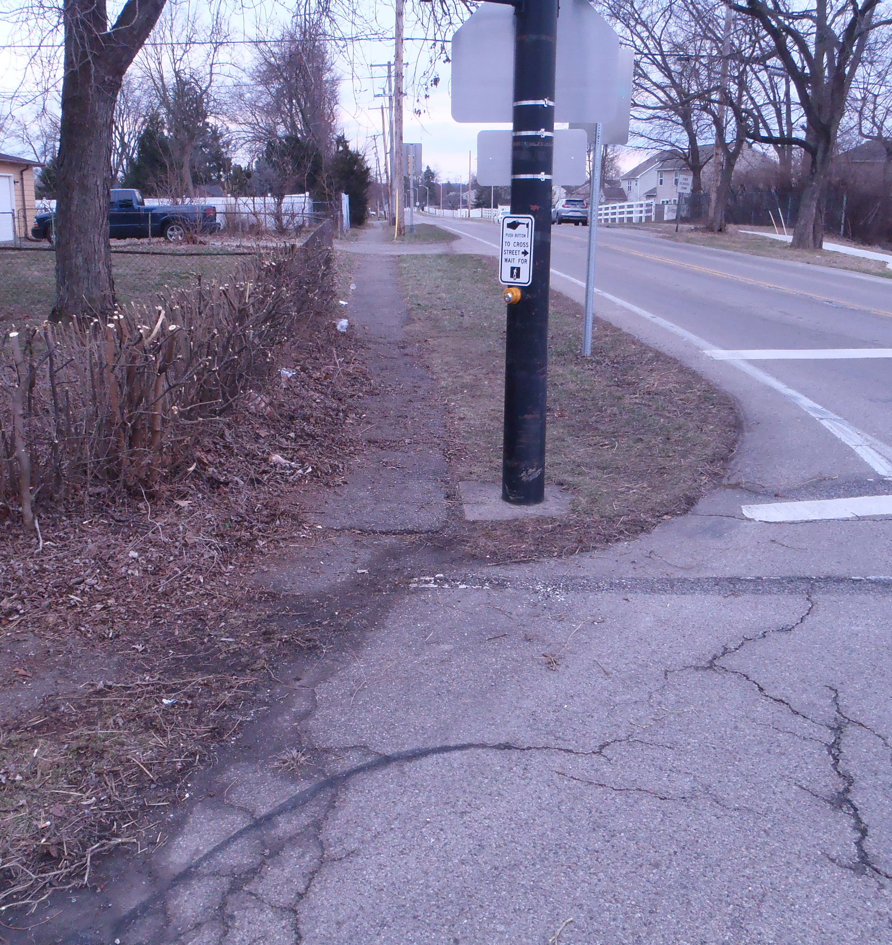
Intersection of Lamme Rd & Owendale Dr.
Left: Northeast corner of Lamme Road & Owendale Road
Right: Southeast corner of Lamme Road & Owendale Road
Note: the Northwest & Southwest ramps were reconstructed as part of the new West Carrollton intermediate school

Slide 7
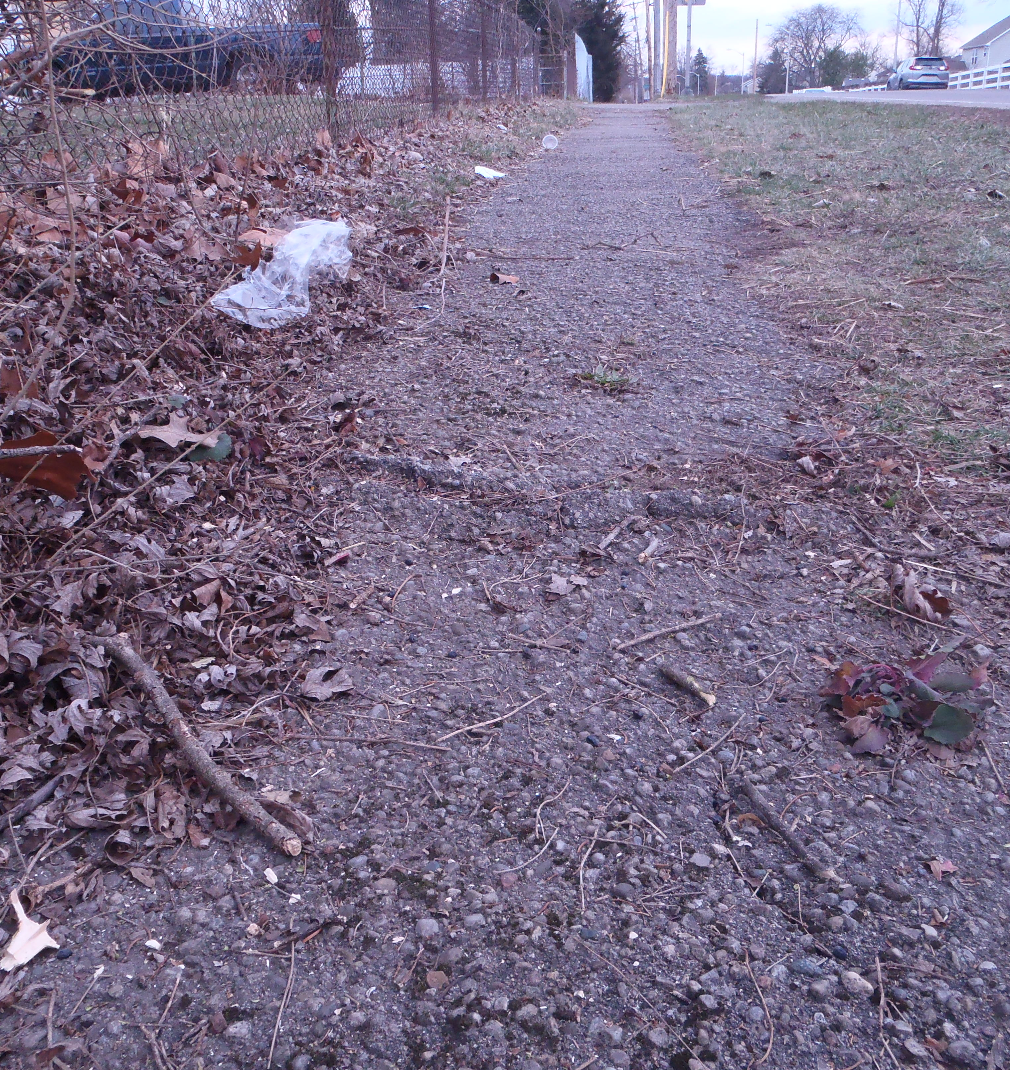
Ex. asphalt walk along east side of Lamme Rd between Owendale Dr. & Terrylynn Ave.
Left & Right: looking southbound along existing asphalt walk. Note heaving asphalt at cracks within ex. sidewalk. This condition is typical along the length of the asphalt walk.

Slide 8
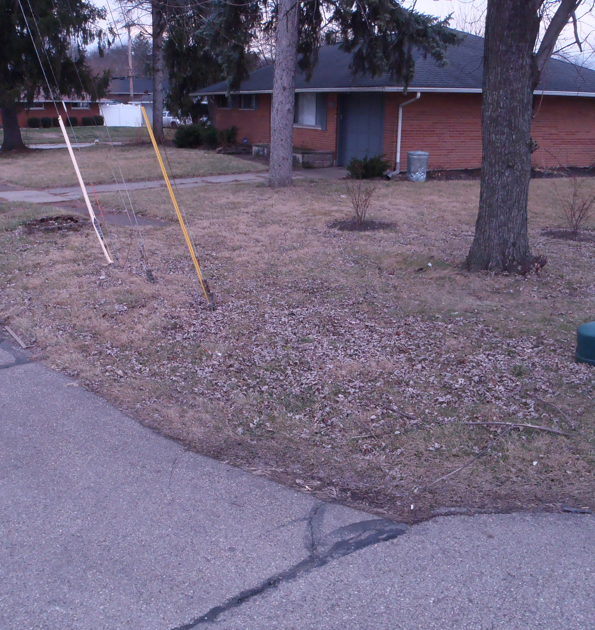
Intersection of Lamme Rd. & Terrylynn Ave.
Left: Northeast corner Lamme Road & Terrylynn Avenue
Right: Southeast corner Lamme Road & Terrylynn Avenue

Slide 9
Intersection of Lamme Rd. & Terrylynn Ave.
Northwest corner Lamme Road & Terrylynn Avenue

Slide 10
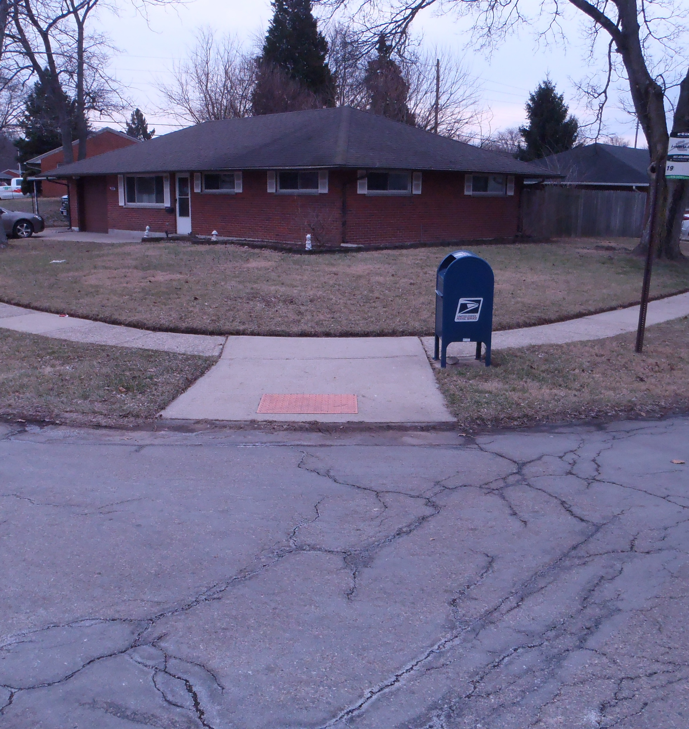
Intersection of Lamme Rd. & Lehigh Pl.
Left: Northeast corner Lamme Road & Lehigh Place
Right: Southeast corner Lamme Road & Lehigh Place

Slide 11
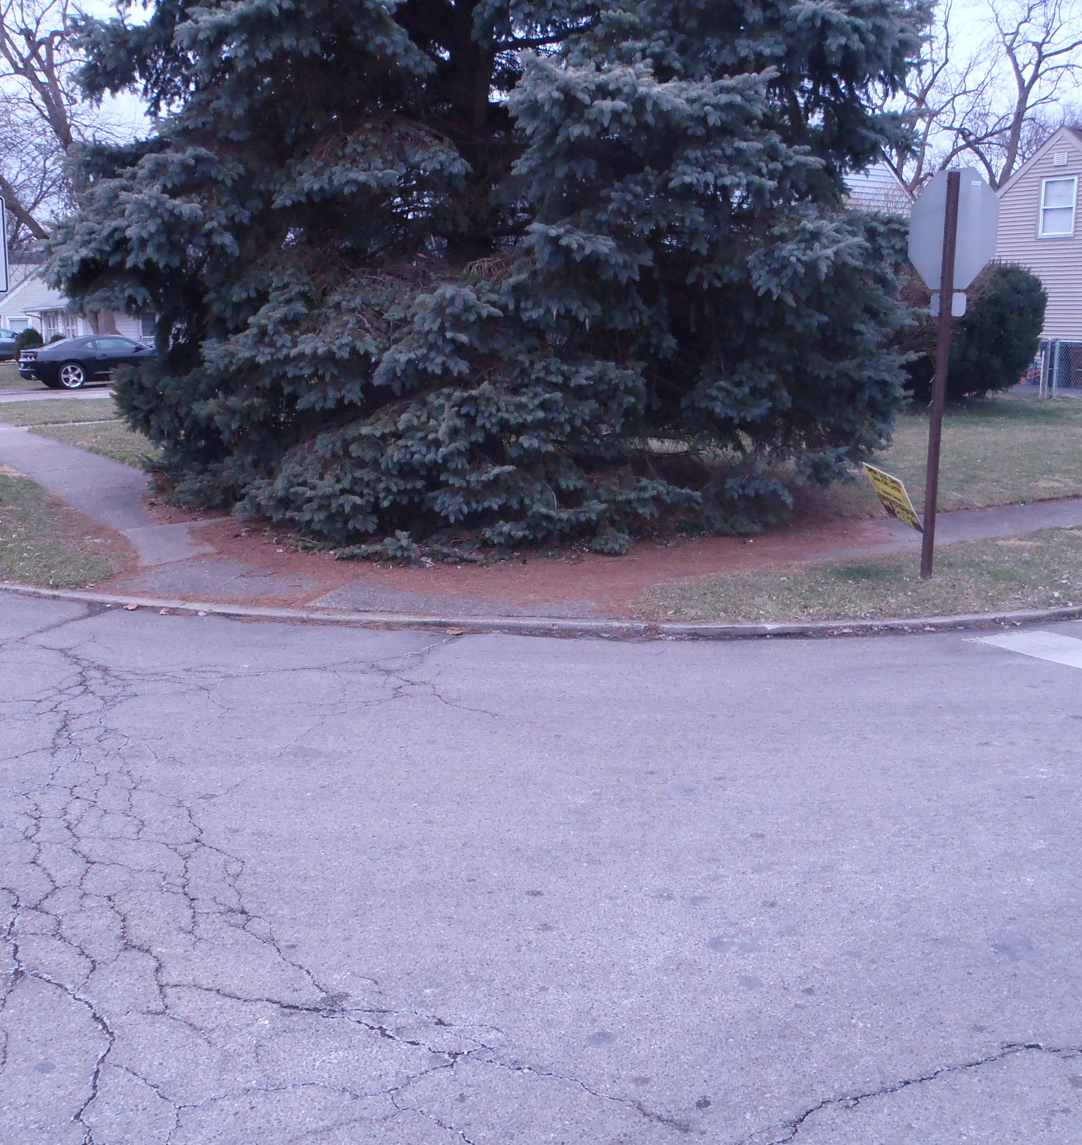
Intersection of Lamme Rd. & Lehigh Pl.
Left: Northwest corner Lamme Road & Lehigh Place
Right: Southwest corner Lamme Road & Lehigh Place

Slide 12
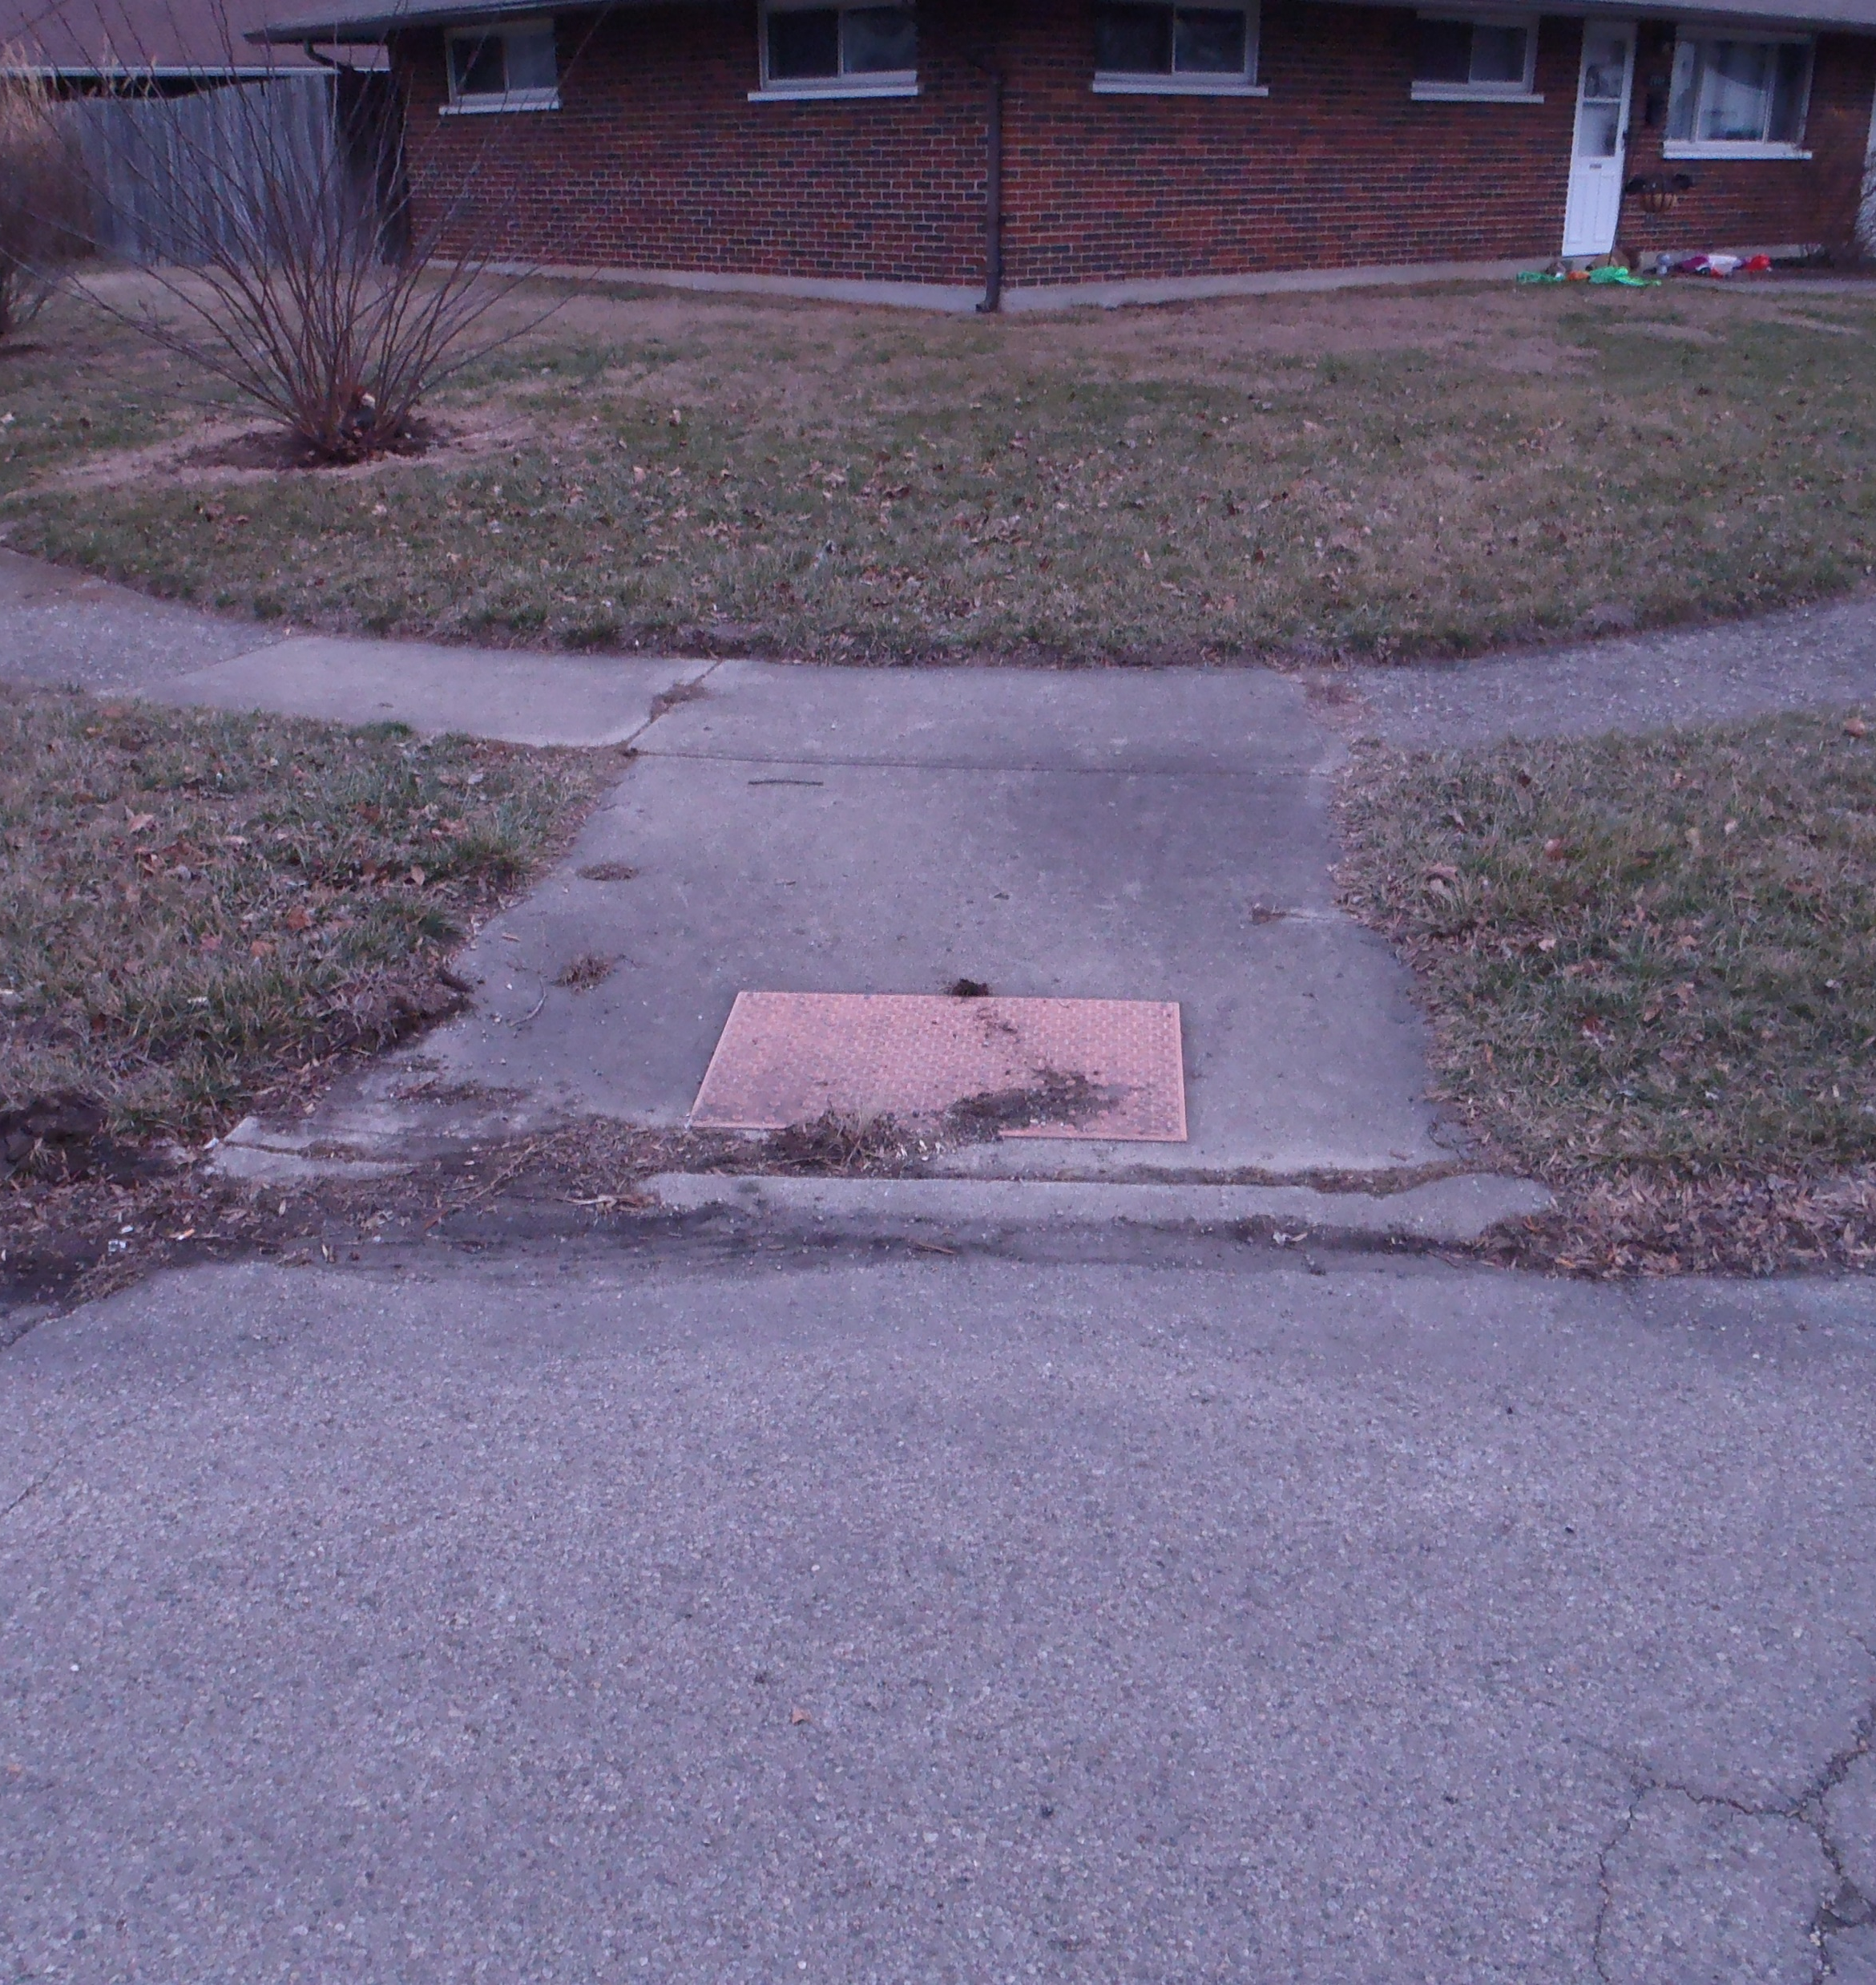
Intesection of Lamme Rd. & Rulla Ct.
Left: Northeast corner Lamme Road & Rulla Court
Right: Southeast corner Lamme Road & Rulla Court

Slide 13
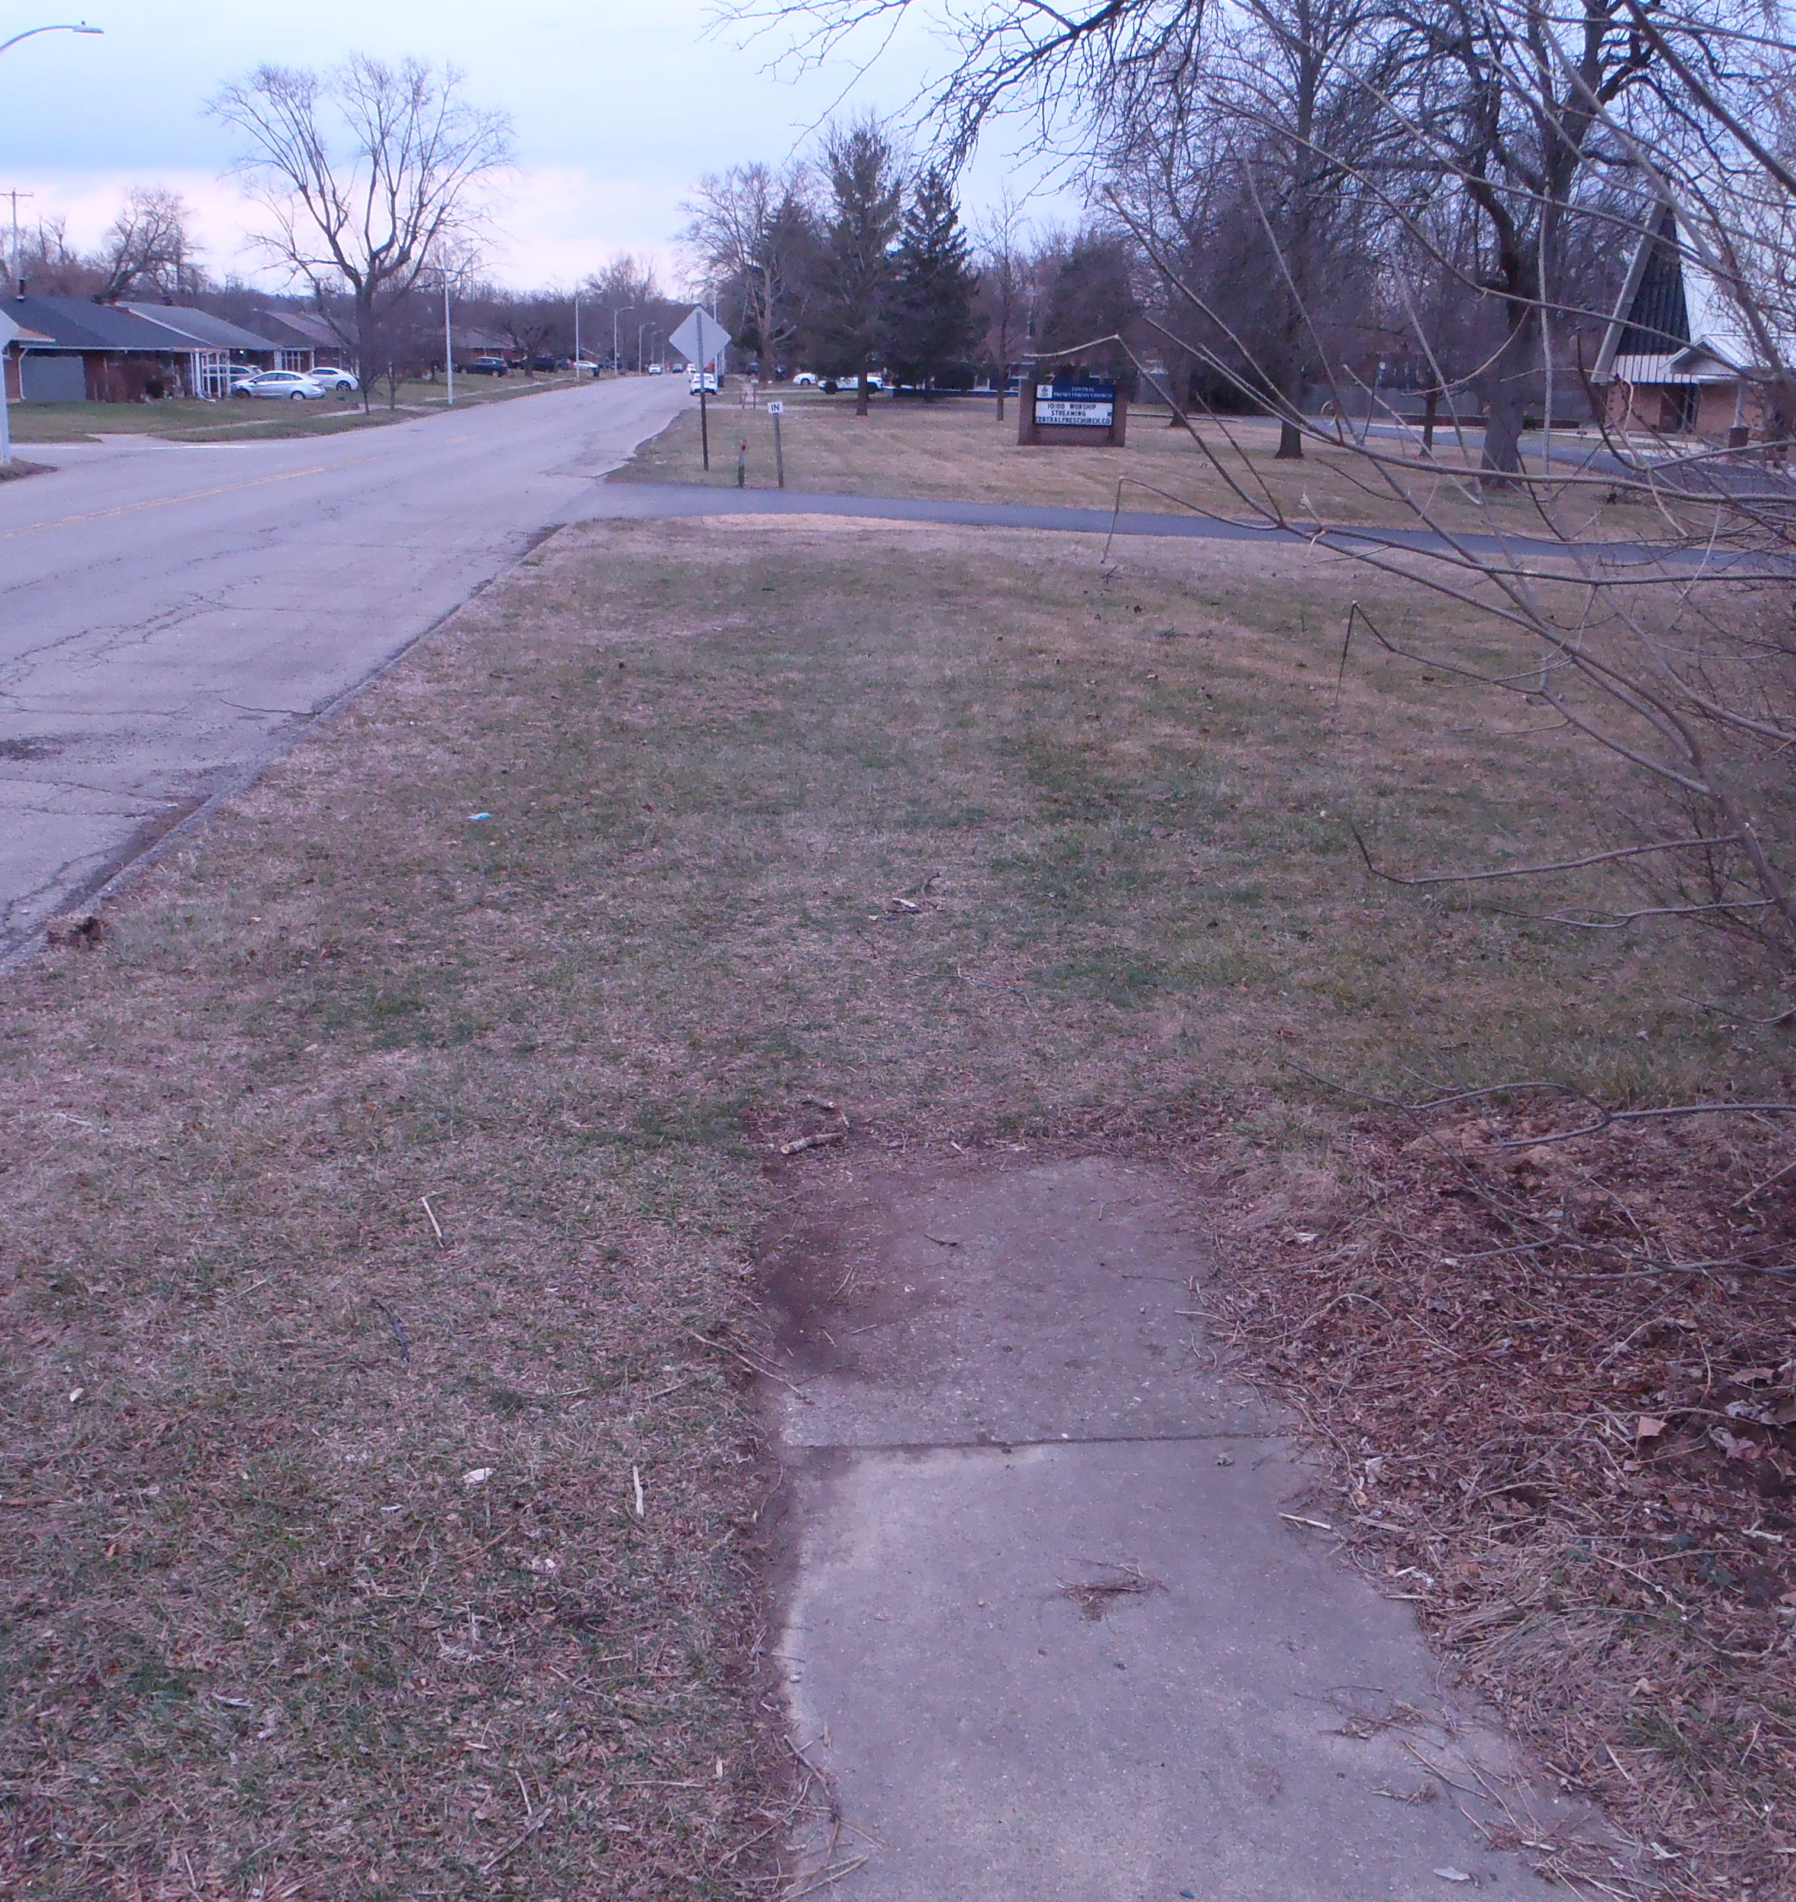
West side of Lamme Road along frontage of Presbyterian Church Parcel
Left: Looking south along the west side of Lamme Road
Right: Looking north along the west side of Lamme Road

Slide 14
IMPACTED PROPERTIES AND RESPECTIVE OWNERS
NORTH
1
6
10
2
3
5
7
9
4
8

Slide 15
IMPACTED PROPERTIES AND RESPECTIVE OWNERS
NORTH
12
16
14
18
11
15
17
19
13

Slide 16
PARCEL 6 - PRESBYTERIAN CHURCH
NORTH

Slide 17
PARCEL 6 - PRESBYTERIAN CHURCH
NORTH
6
Purpose of temporary easement is for required grading due to new walk to ensure positive drainage.

Slide 18
PARCEL 6 - PRESBYTERIAN CHURCH
Looking south at Northern drive. Drive is not to be disturbed. Existing sign and reflector post will be removed

Slide 19
PARCEL 6 - PRESBYTERIAN CHURCH
Looking south along frontage of Presbyterian Church parcel.

Slide 20
PARCEL 6 - PRESBYTERIAN CHURCH
Looking south at southern drive. Drive is not to be disturbed. Existing sign and reflector posts will be removed.

Slide 21
Parcel 15 - Holding & parcel 19 - VB One
NORTH

Slide 22
Parcel 15 - Holding
NORTH
15
Purpose of temporary easement is to reconstruct drive apron due to new sidewalk and perform required grading to ensure positive drainage.

Slide 23
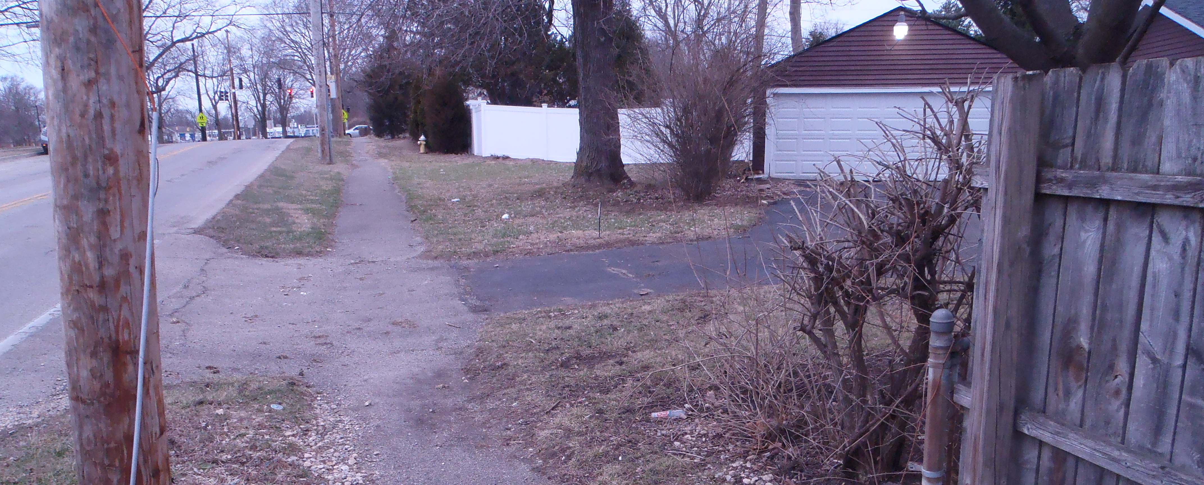
Parcel 15 - Holding
Looking north at drive to #15 Holdings Parcel. New concrete drive apron will tie into existing asphalt drive.

Slide 24
parcel 19 - VB One
NORTH
19
Purpose of temporary easement is to reconstruct drive apron due to new sidewalk.

Slide 25
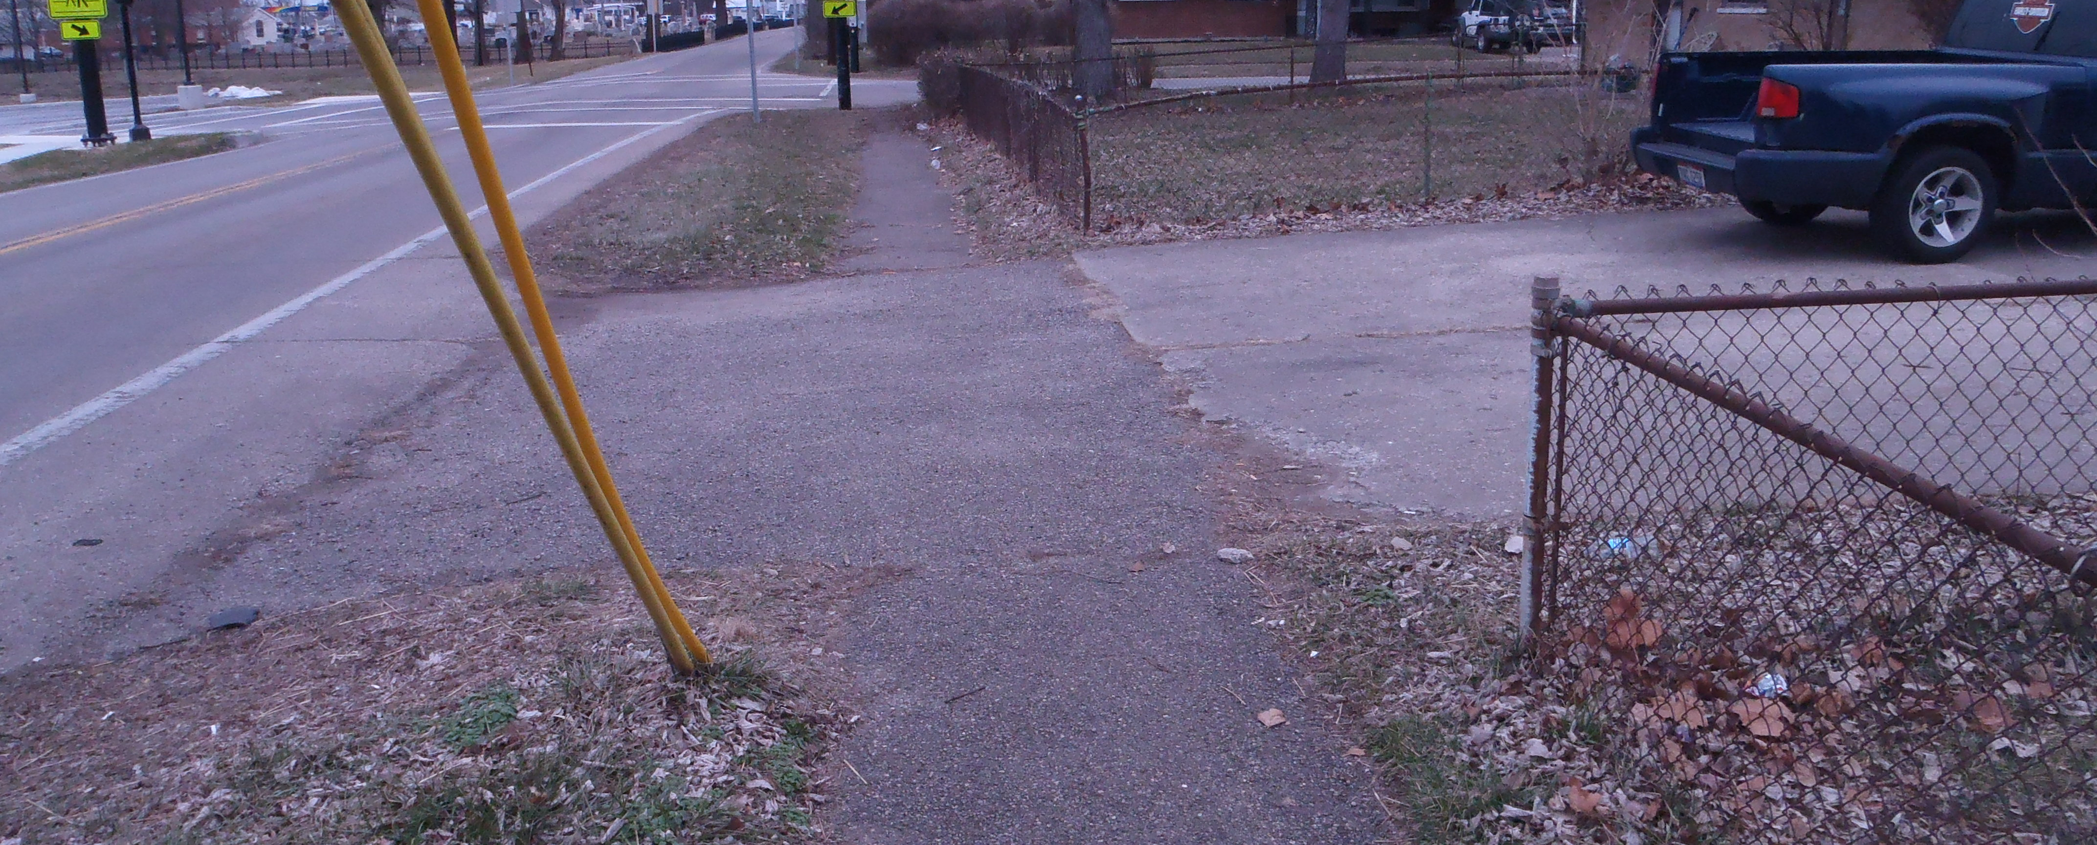
parcel 19 - VB One
Looking north at drive to #19 VB One Parcel. New concrete drive apron will tie into existing concrete drive. Existing fence will not be disturbed.

Slide 26
PROJECT COSTS
Design: by MCEO
Right-of-Way: To be determined by real estate appraisal
Construction: $250,000
Total Project Costs: $250,000

Slide 27
PROJECT SCHEDULE
Design: June 2022 – April 2023
Right-of-Way: May 2023 – October 2023
Advertise & Award: November 2023 – December 2023
Construction: March 2024 thru July 2024
Traffic on Lamme Road and side streets will be maintained during construction.

Slide 28
Questions?

Slide 29
Office of the Montgomery County Engineer

