Slide 2
WAGNER FORD road BRIDGE REHABILITATION moT-cr218-1.00

Slide 3
PROJECT LOCATION
N
CSX RR
PROJECT LOCATION
WAGNER FORD ROAD

Slide 4
Project Scope
Rehabilitate spalled abutment concrete
Replace expansion joints, add pedestrian fence, seal bridge deck
Replace approach guardrail

Slide 5
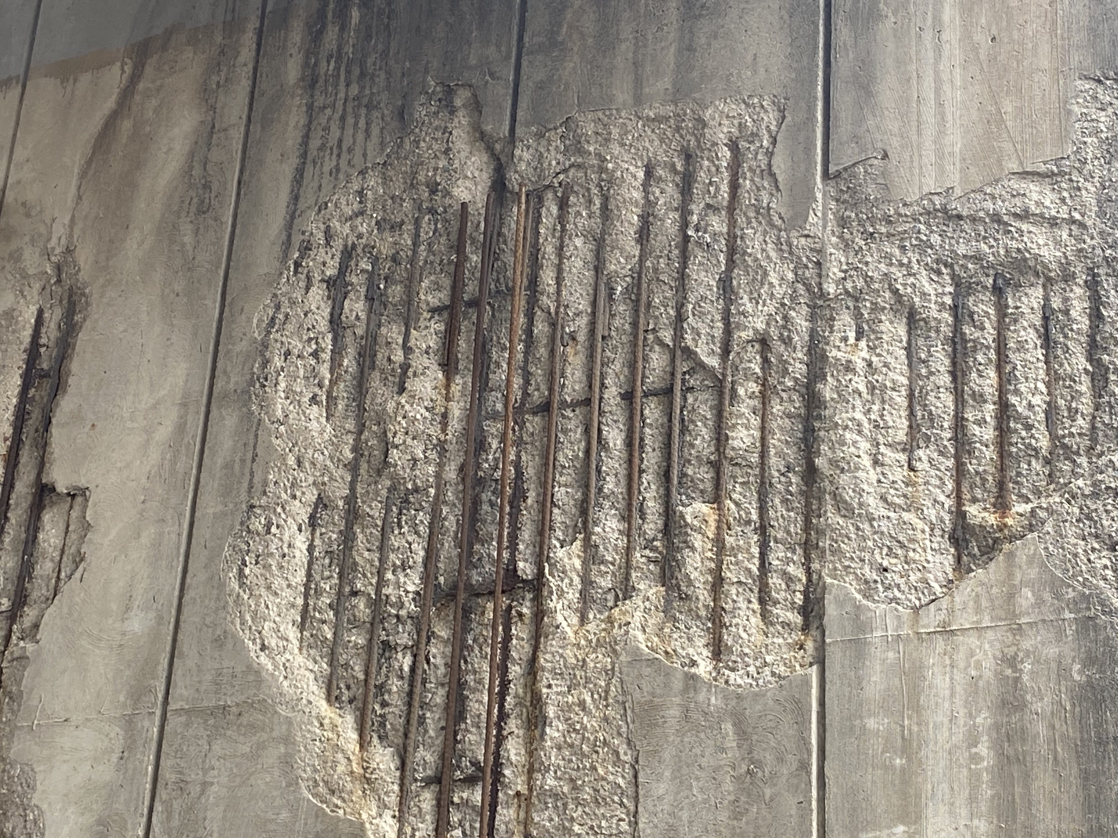
Existing Conditions
Spalled concrete on East abutment
Looking south along CSX mainline tracks

Slide 6
MEASUREMeNT AND TESTING
Abutment corrosion mapping, sampling, and testing

Slide 7
Impacted Properties
N

Slide 8
Impacted Properties
N

Slide 9
Impacted Properties
N

Slide 10
Impacted Properties
N

Slide 11
Impacted Properties
N

Slide 12
Impacted Properties
N

Slide 13
EXISTING RIGHT-OF-WAY
NORTH

Slide 14
Rumpke waste, Inc.
Contractor access to West abutment will be made from within existing Right of Way; no property acquisition required
NORTH
Rumpke Dayton Office
End of Public Service Road

Slide 15
City of Dayton
Temporary easement required to access East abutment work zone (thru CSX easement) from Dayton Park Drive
NORTH
CSX Needmore Yard
Dayton Park Drive

Slide 16
CSX Transportation
Temporary easement required to access East abutment work zone from Dayton Park Drive
NORTH
CSX Needmore Yard
Dayton Park Drive

Slide 17
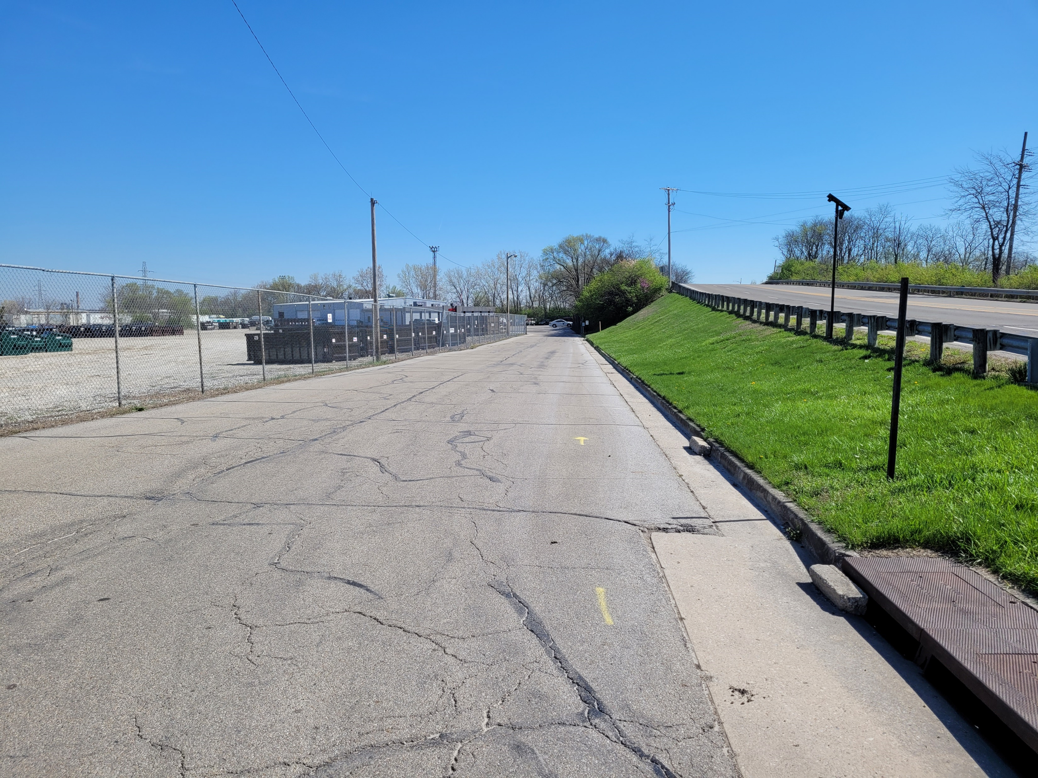
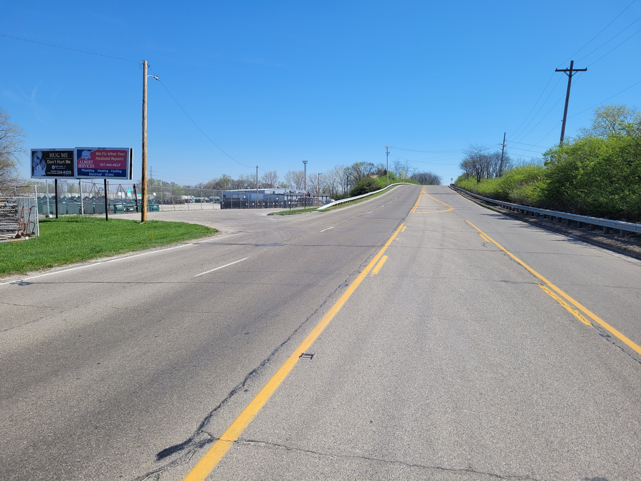
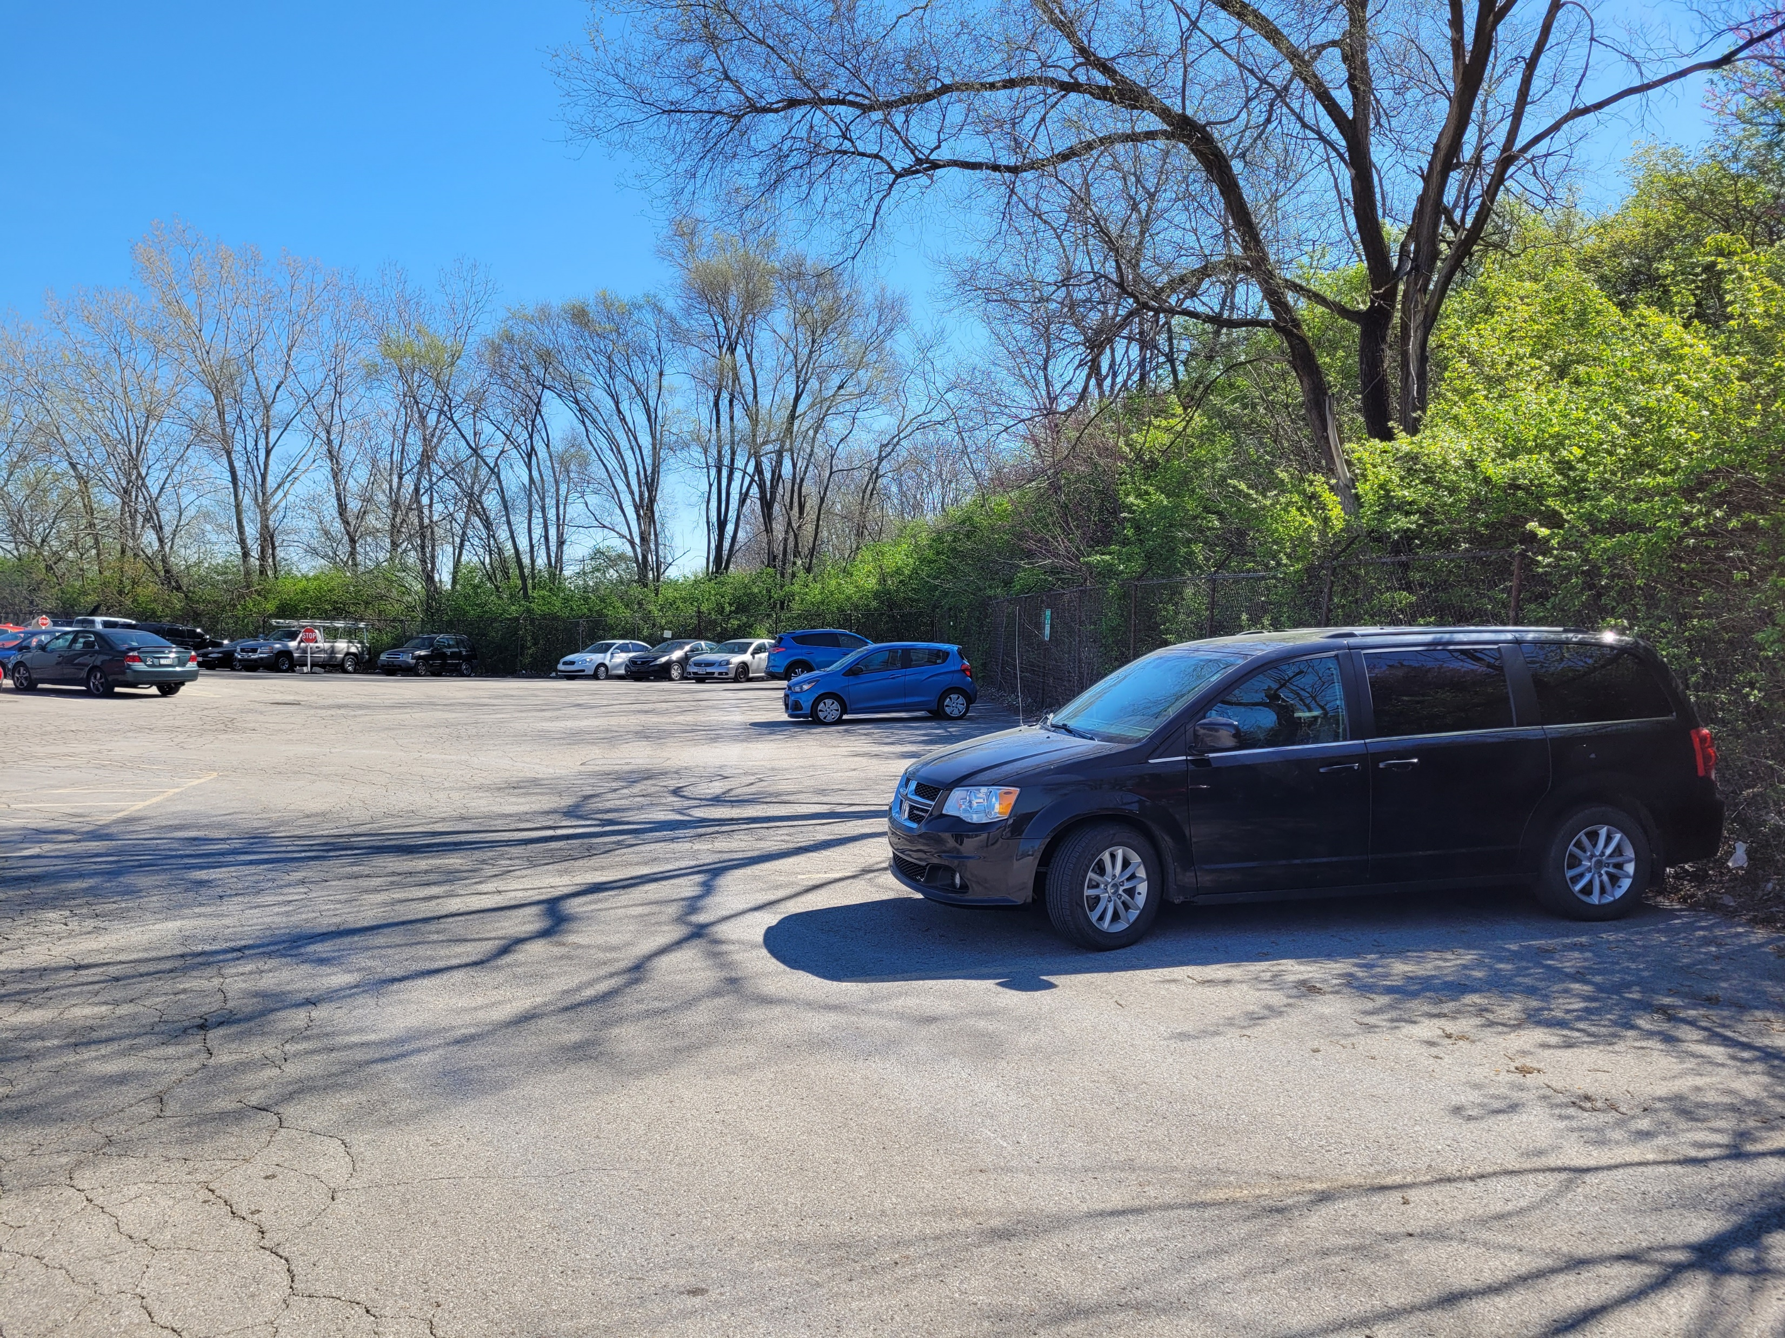
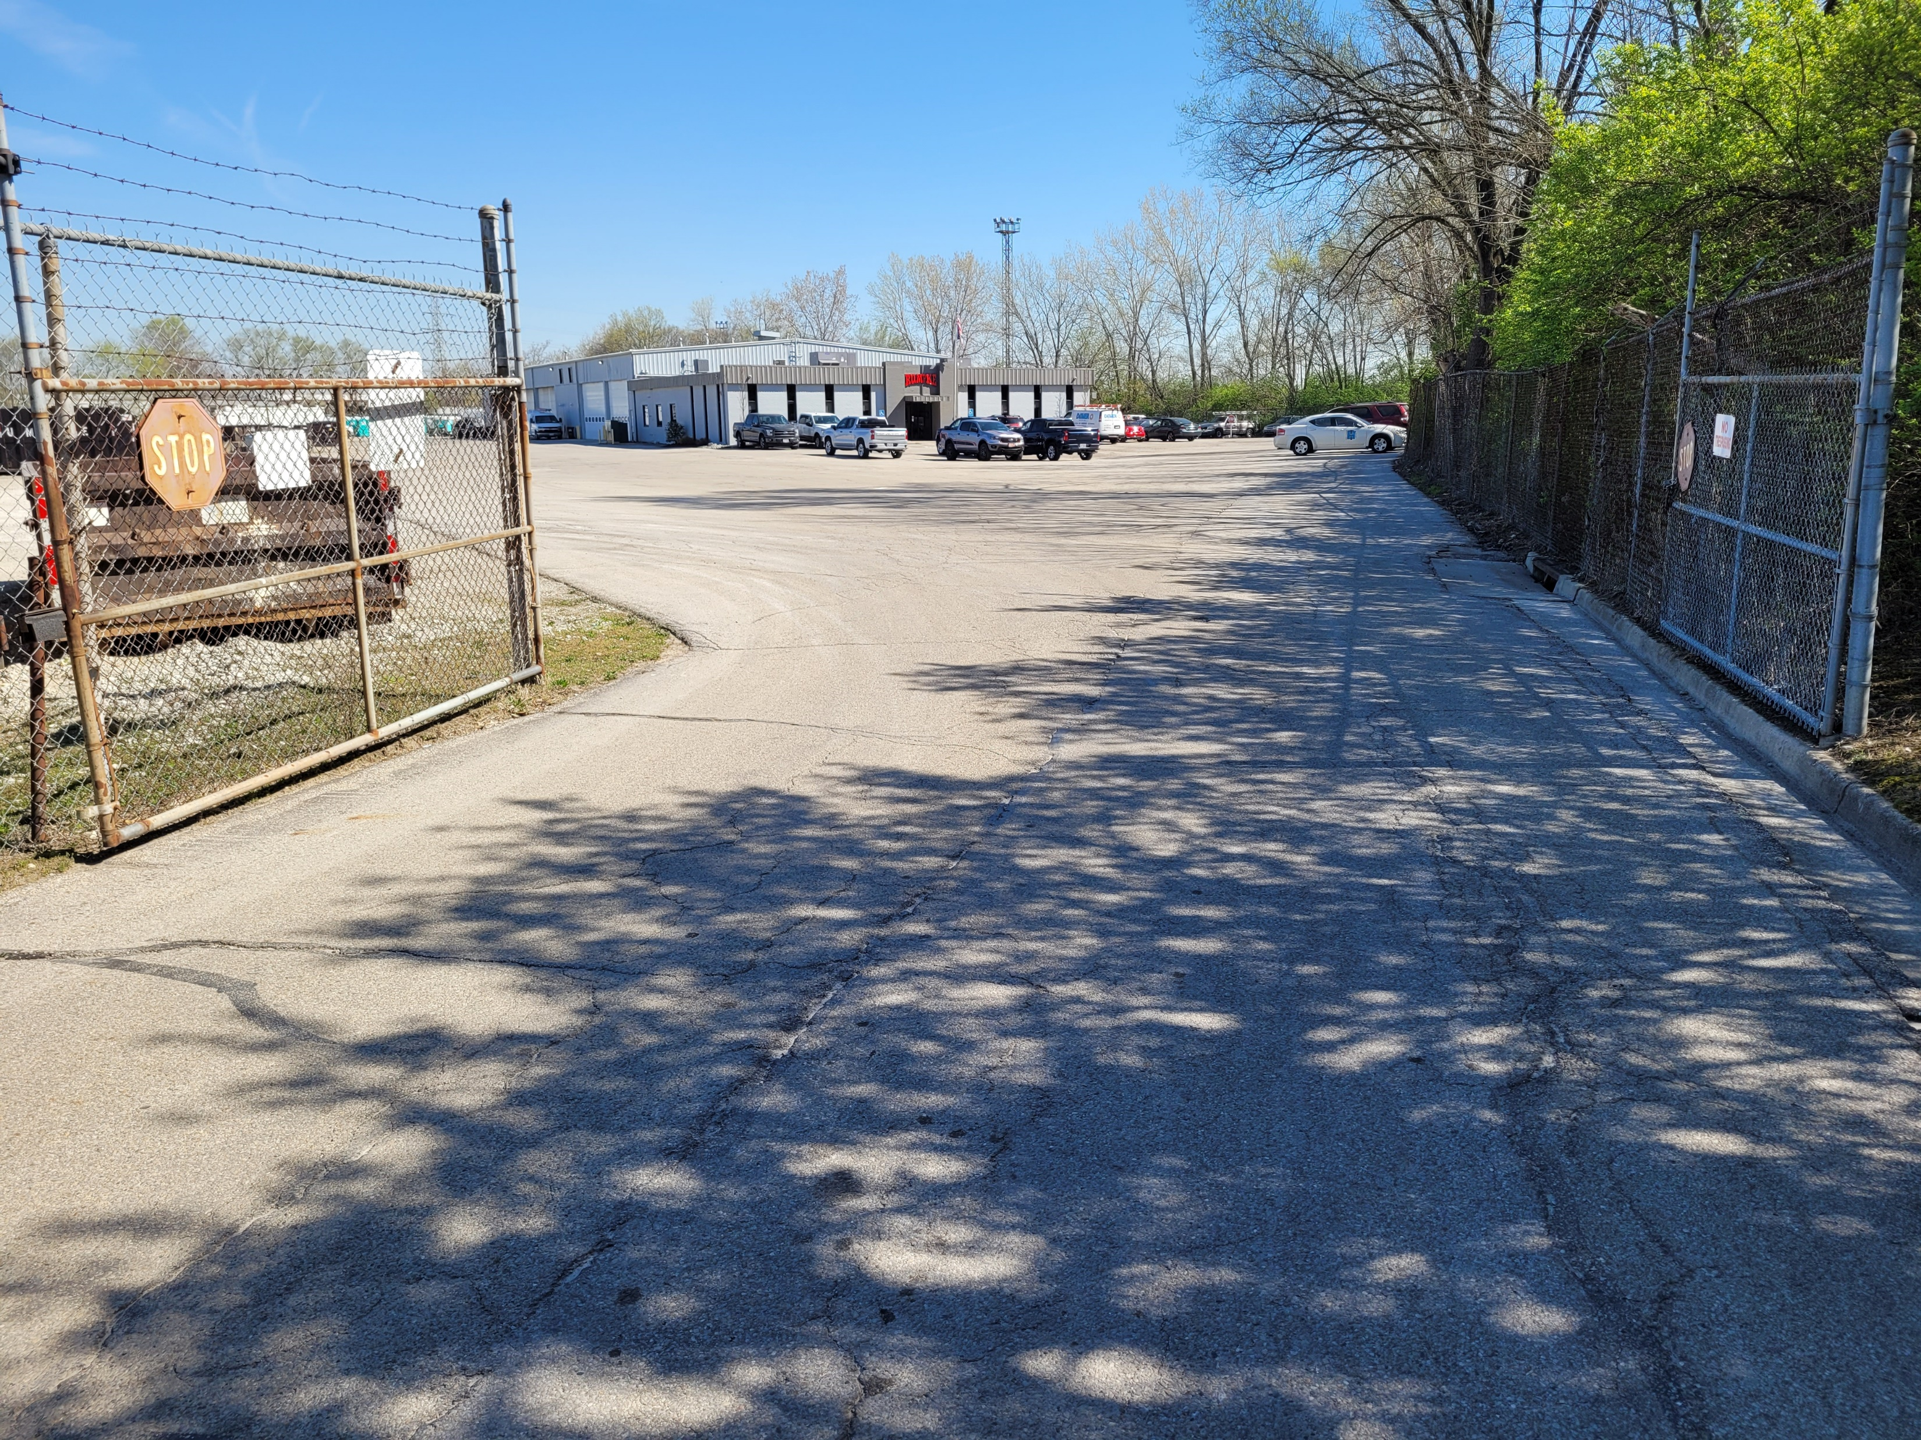
Rumpke Parcel

Slide 18
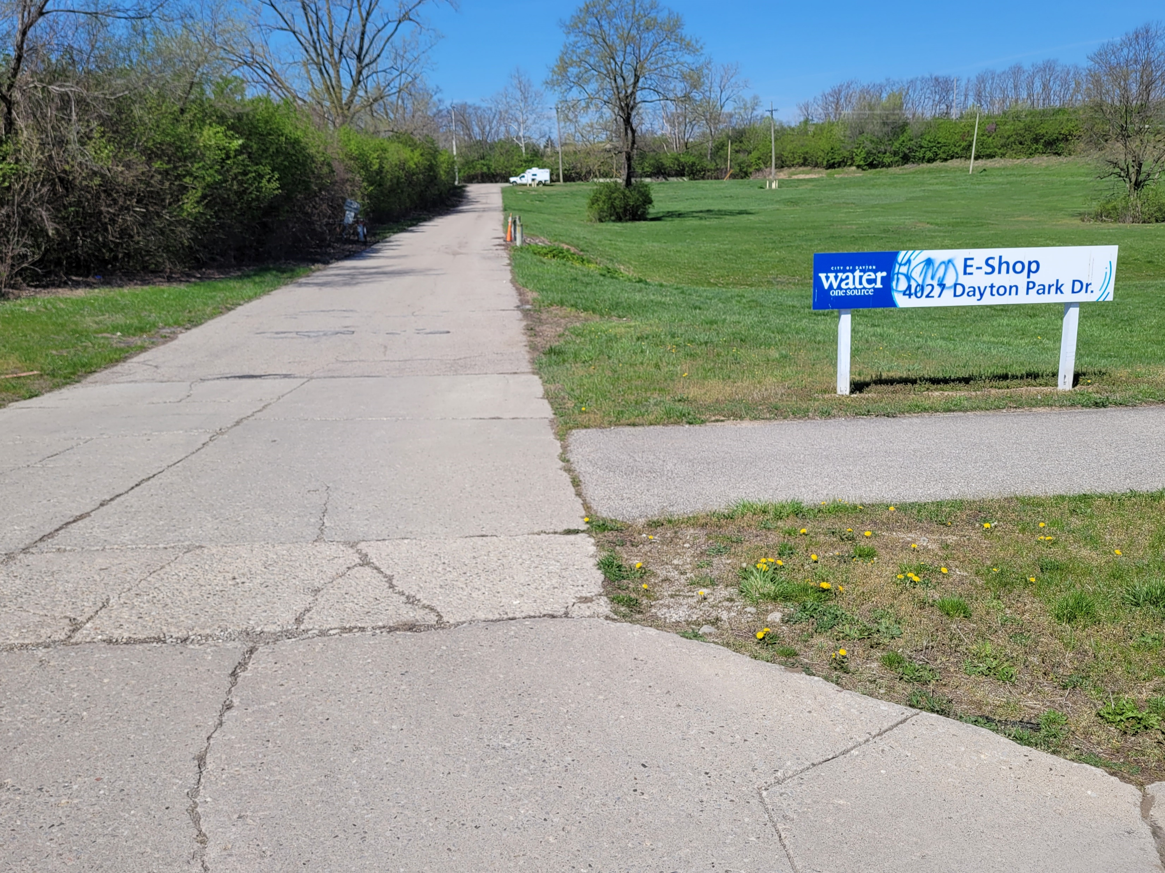
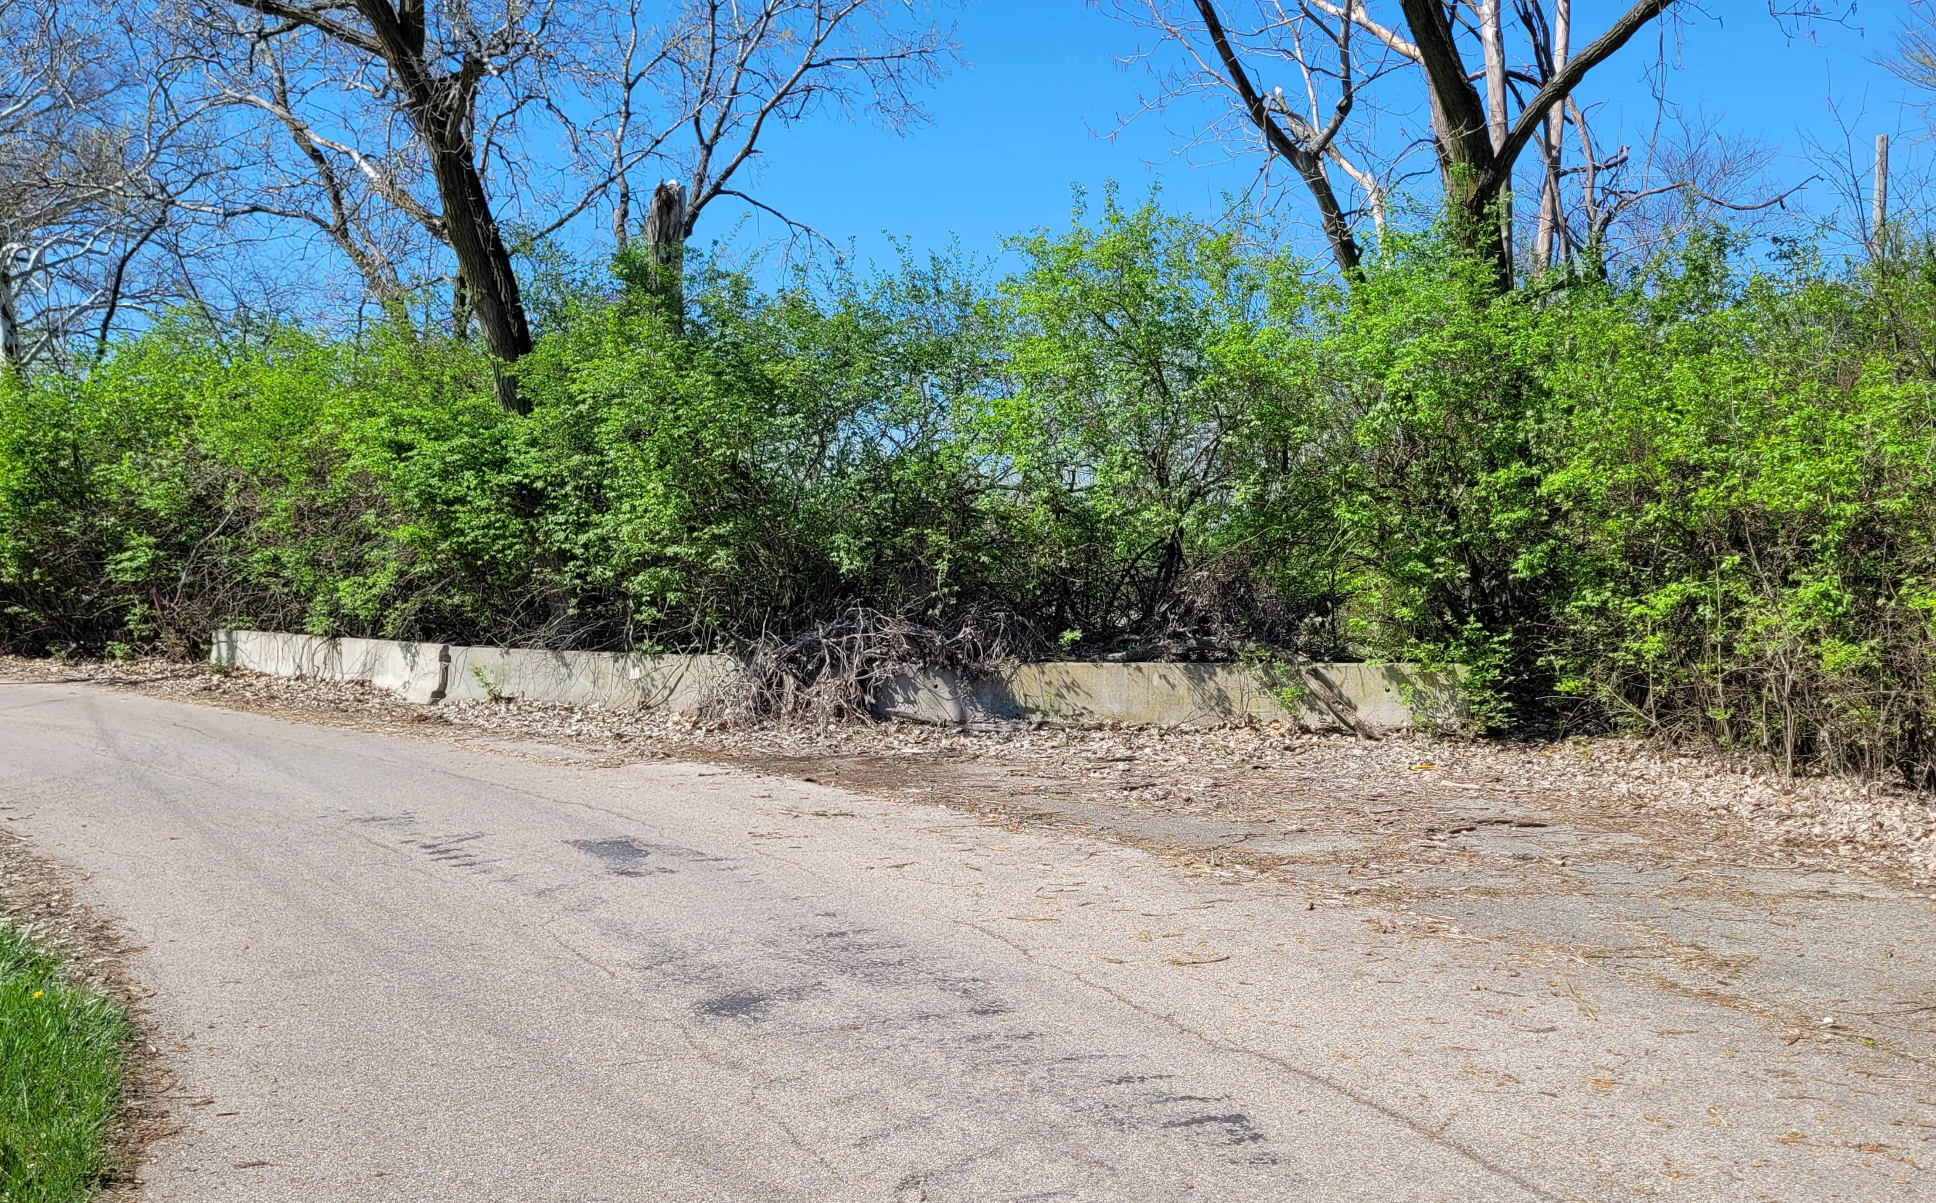
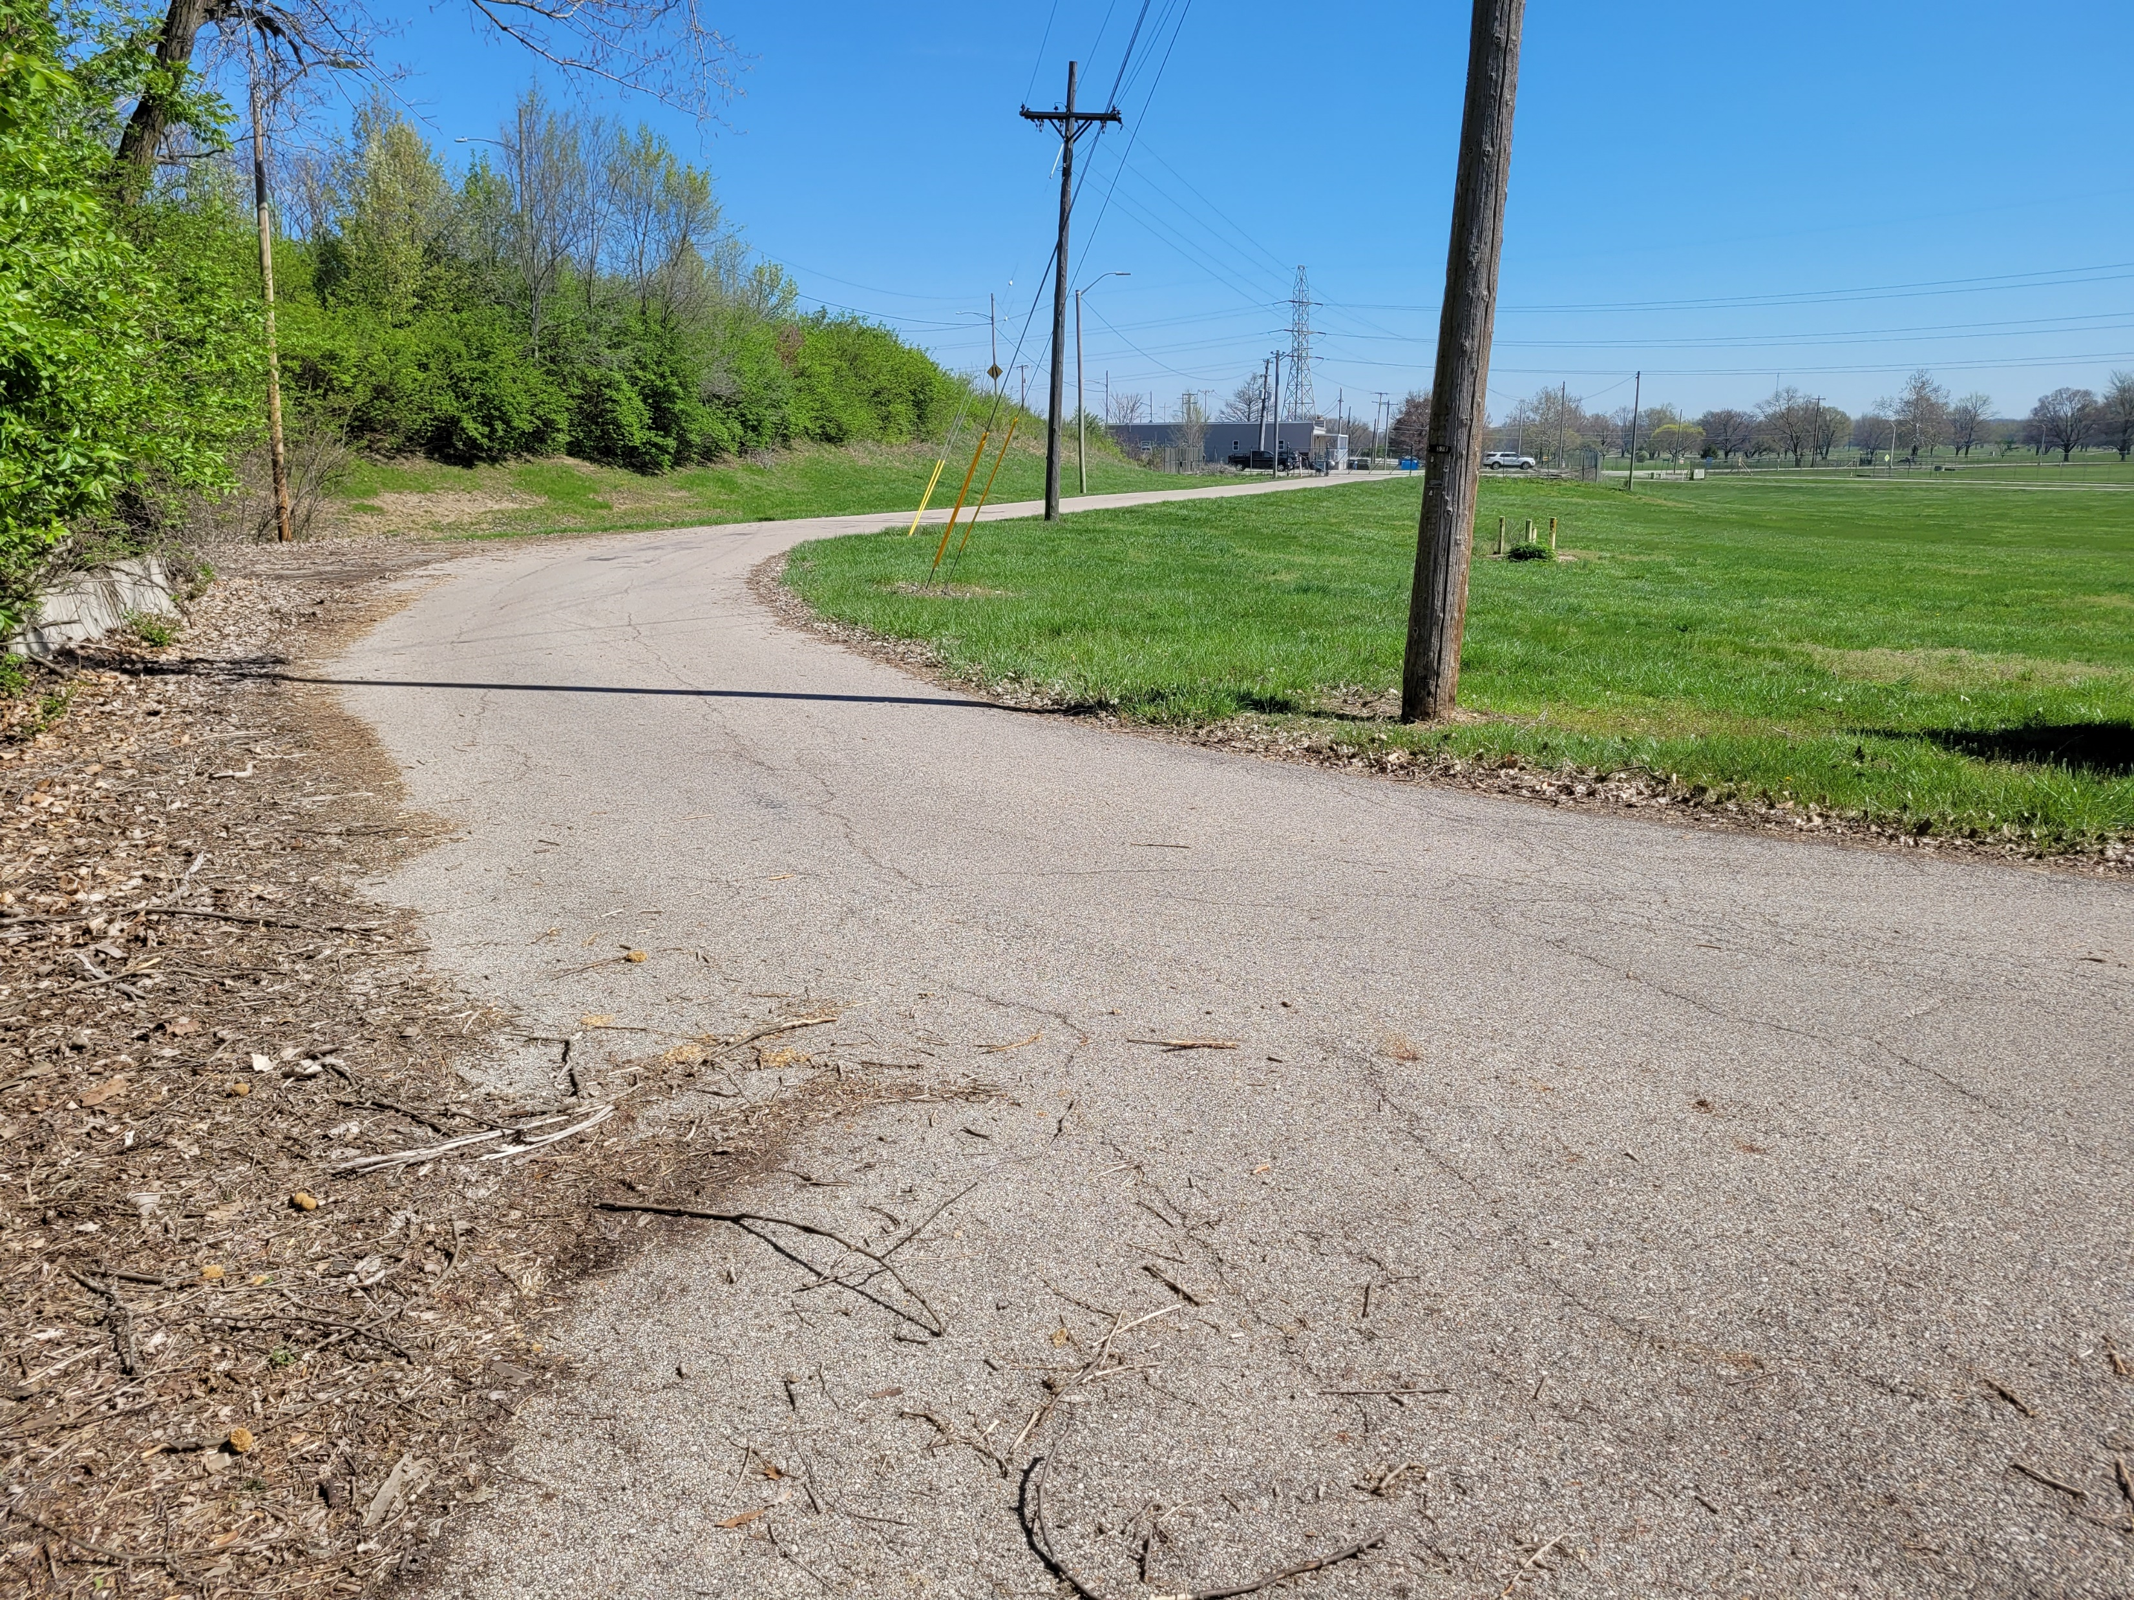
City of Dayton Parcel

Slide 19
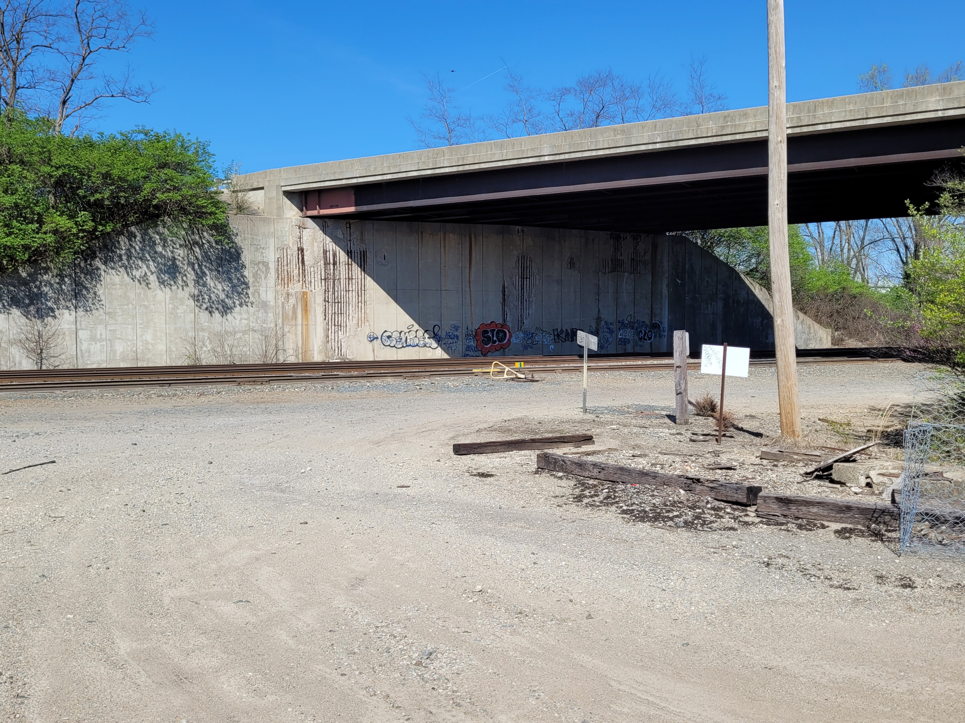
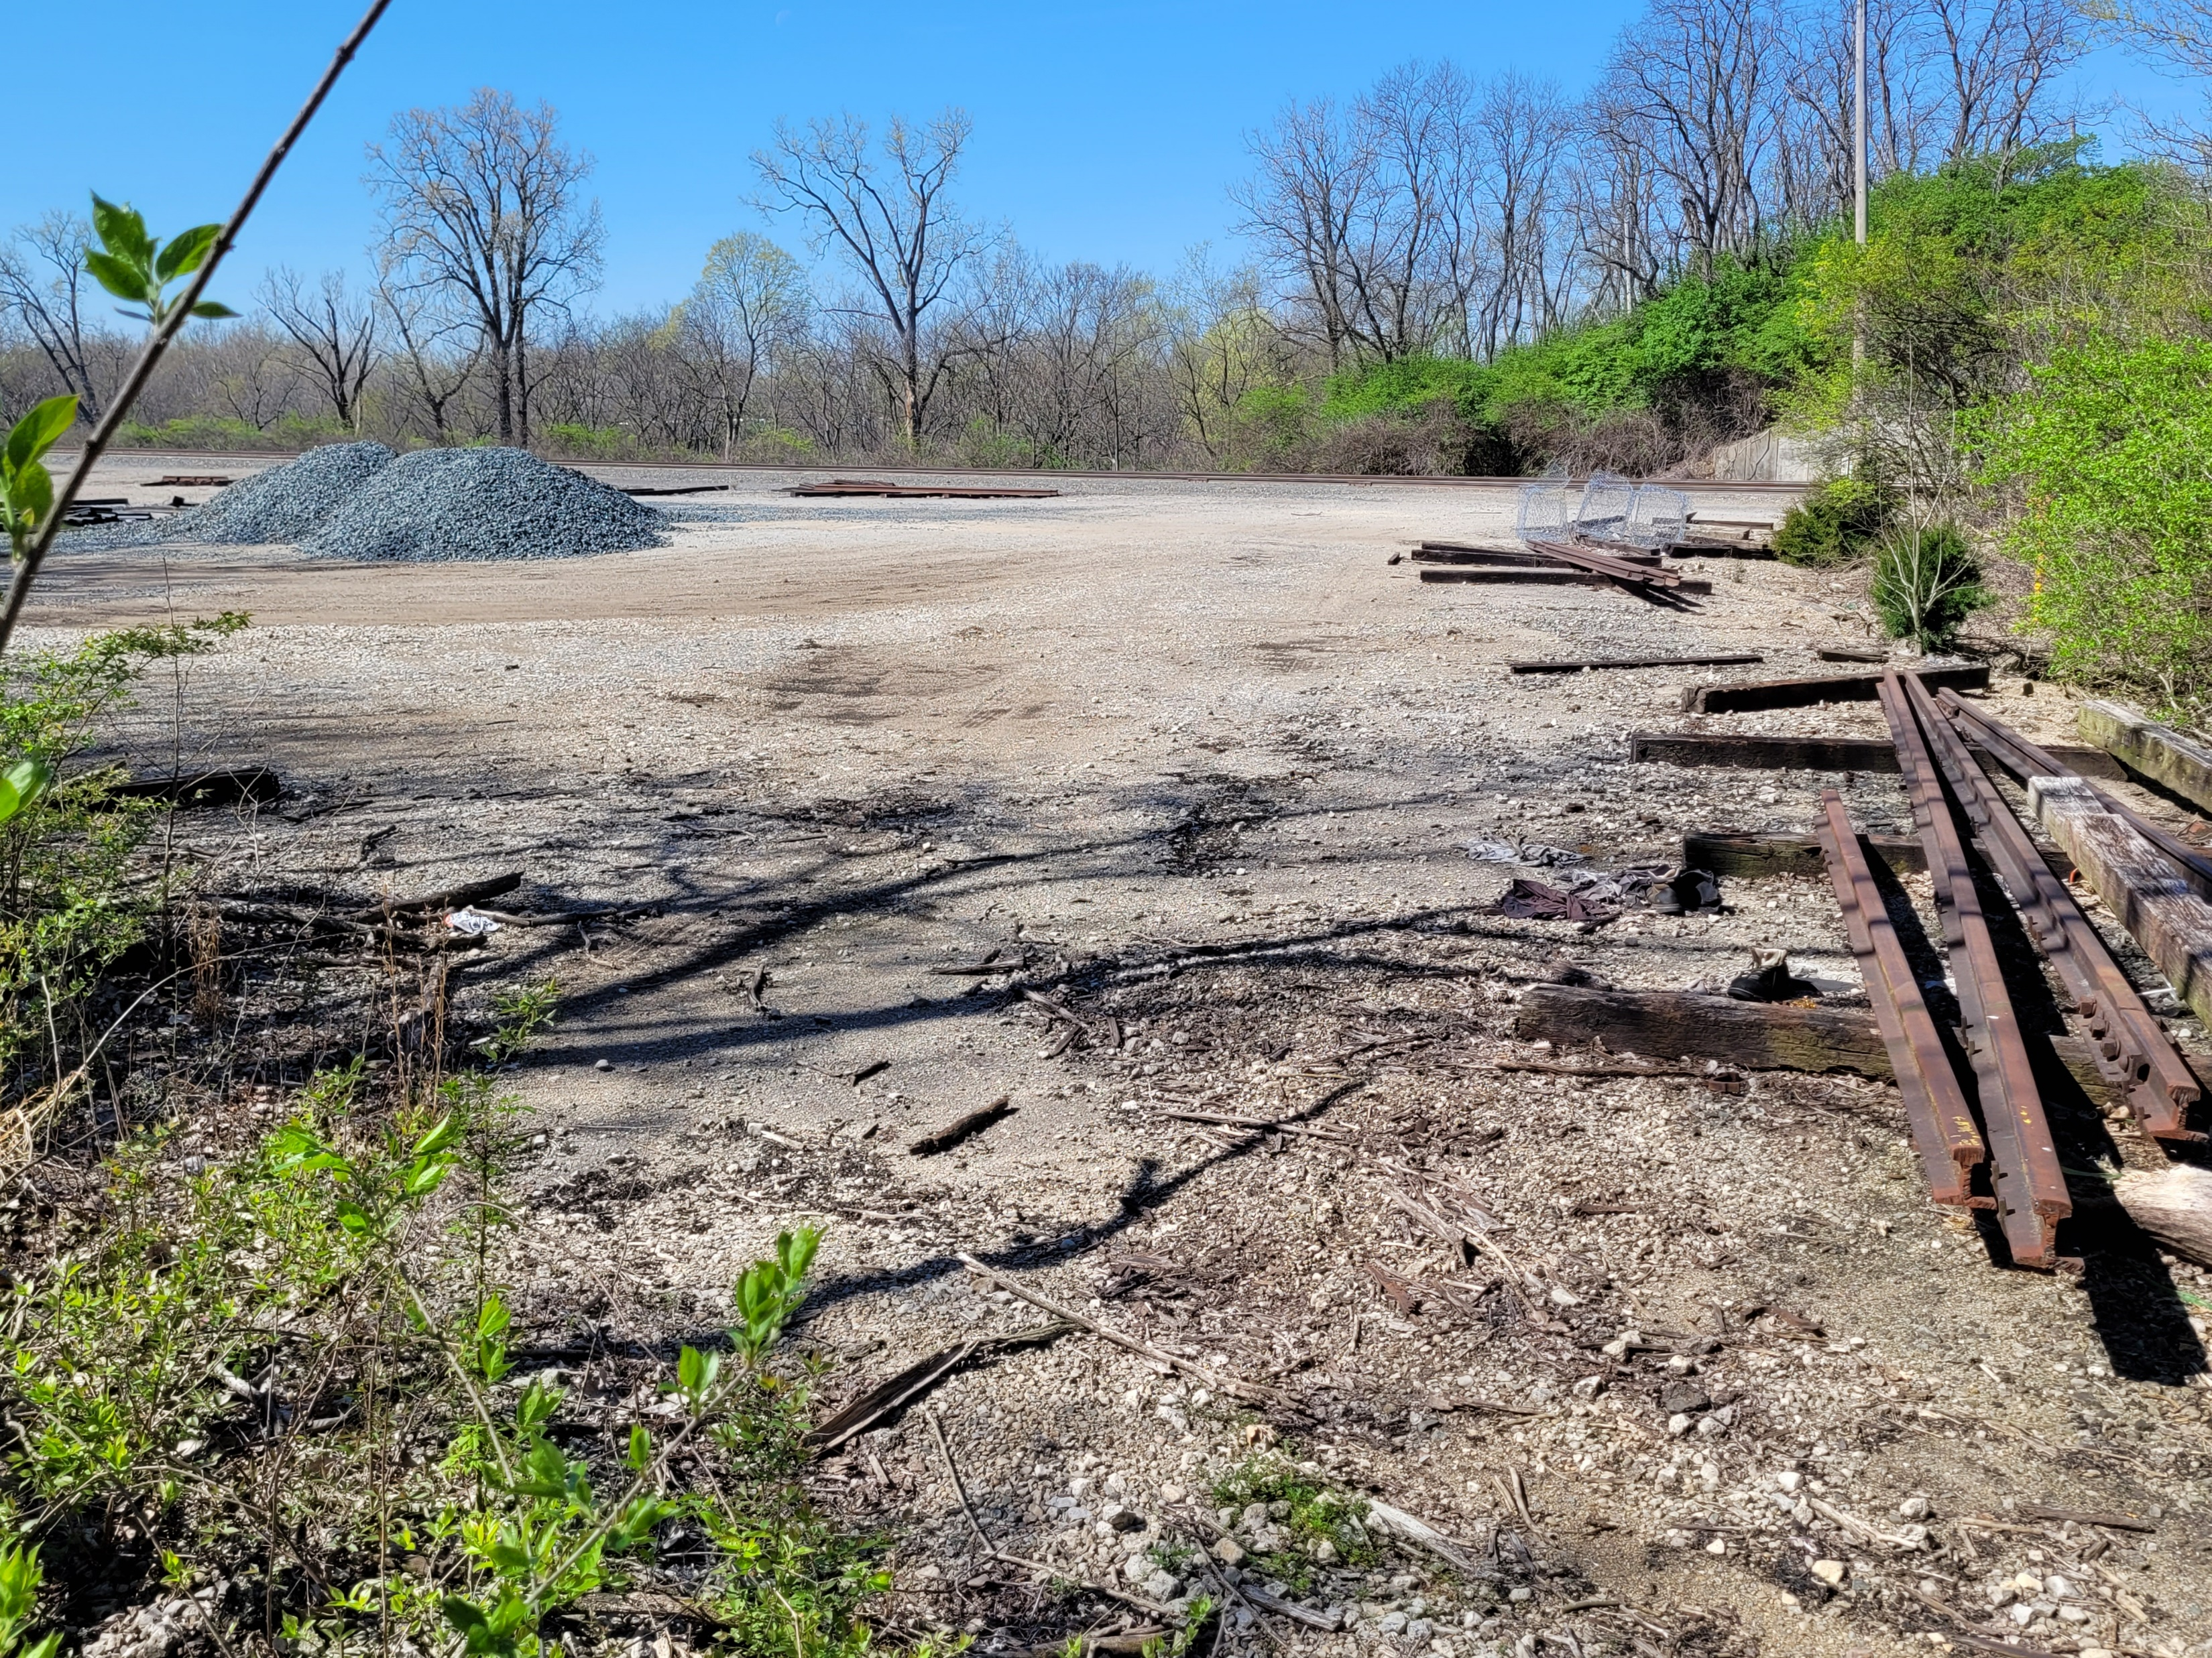
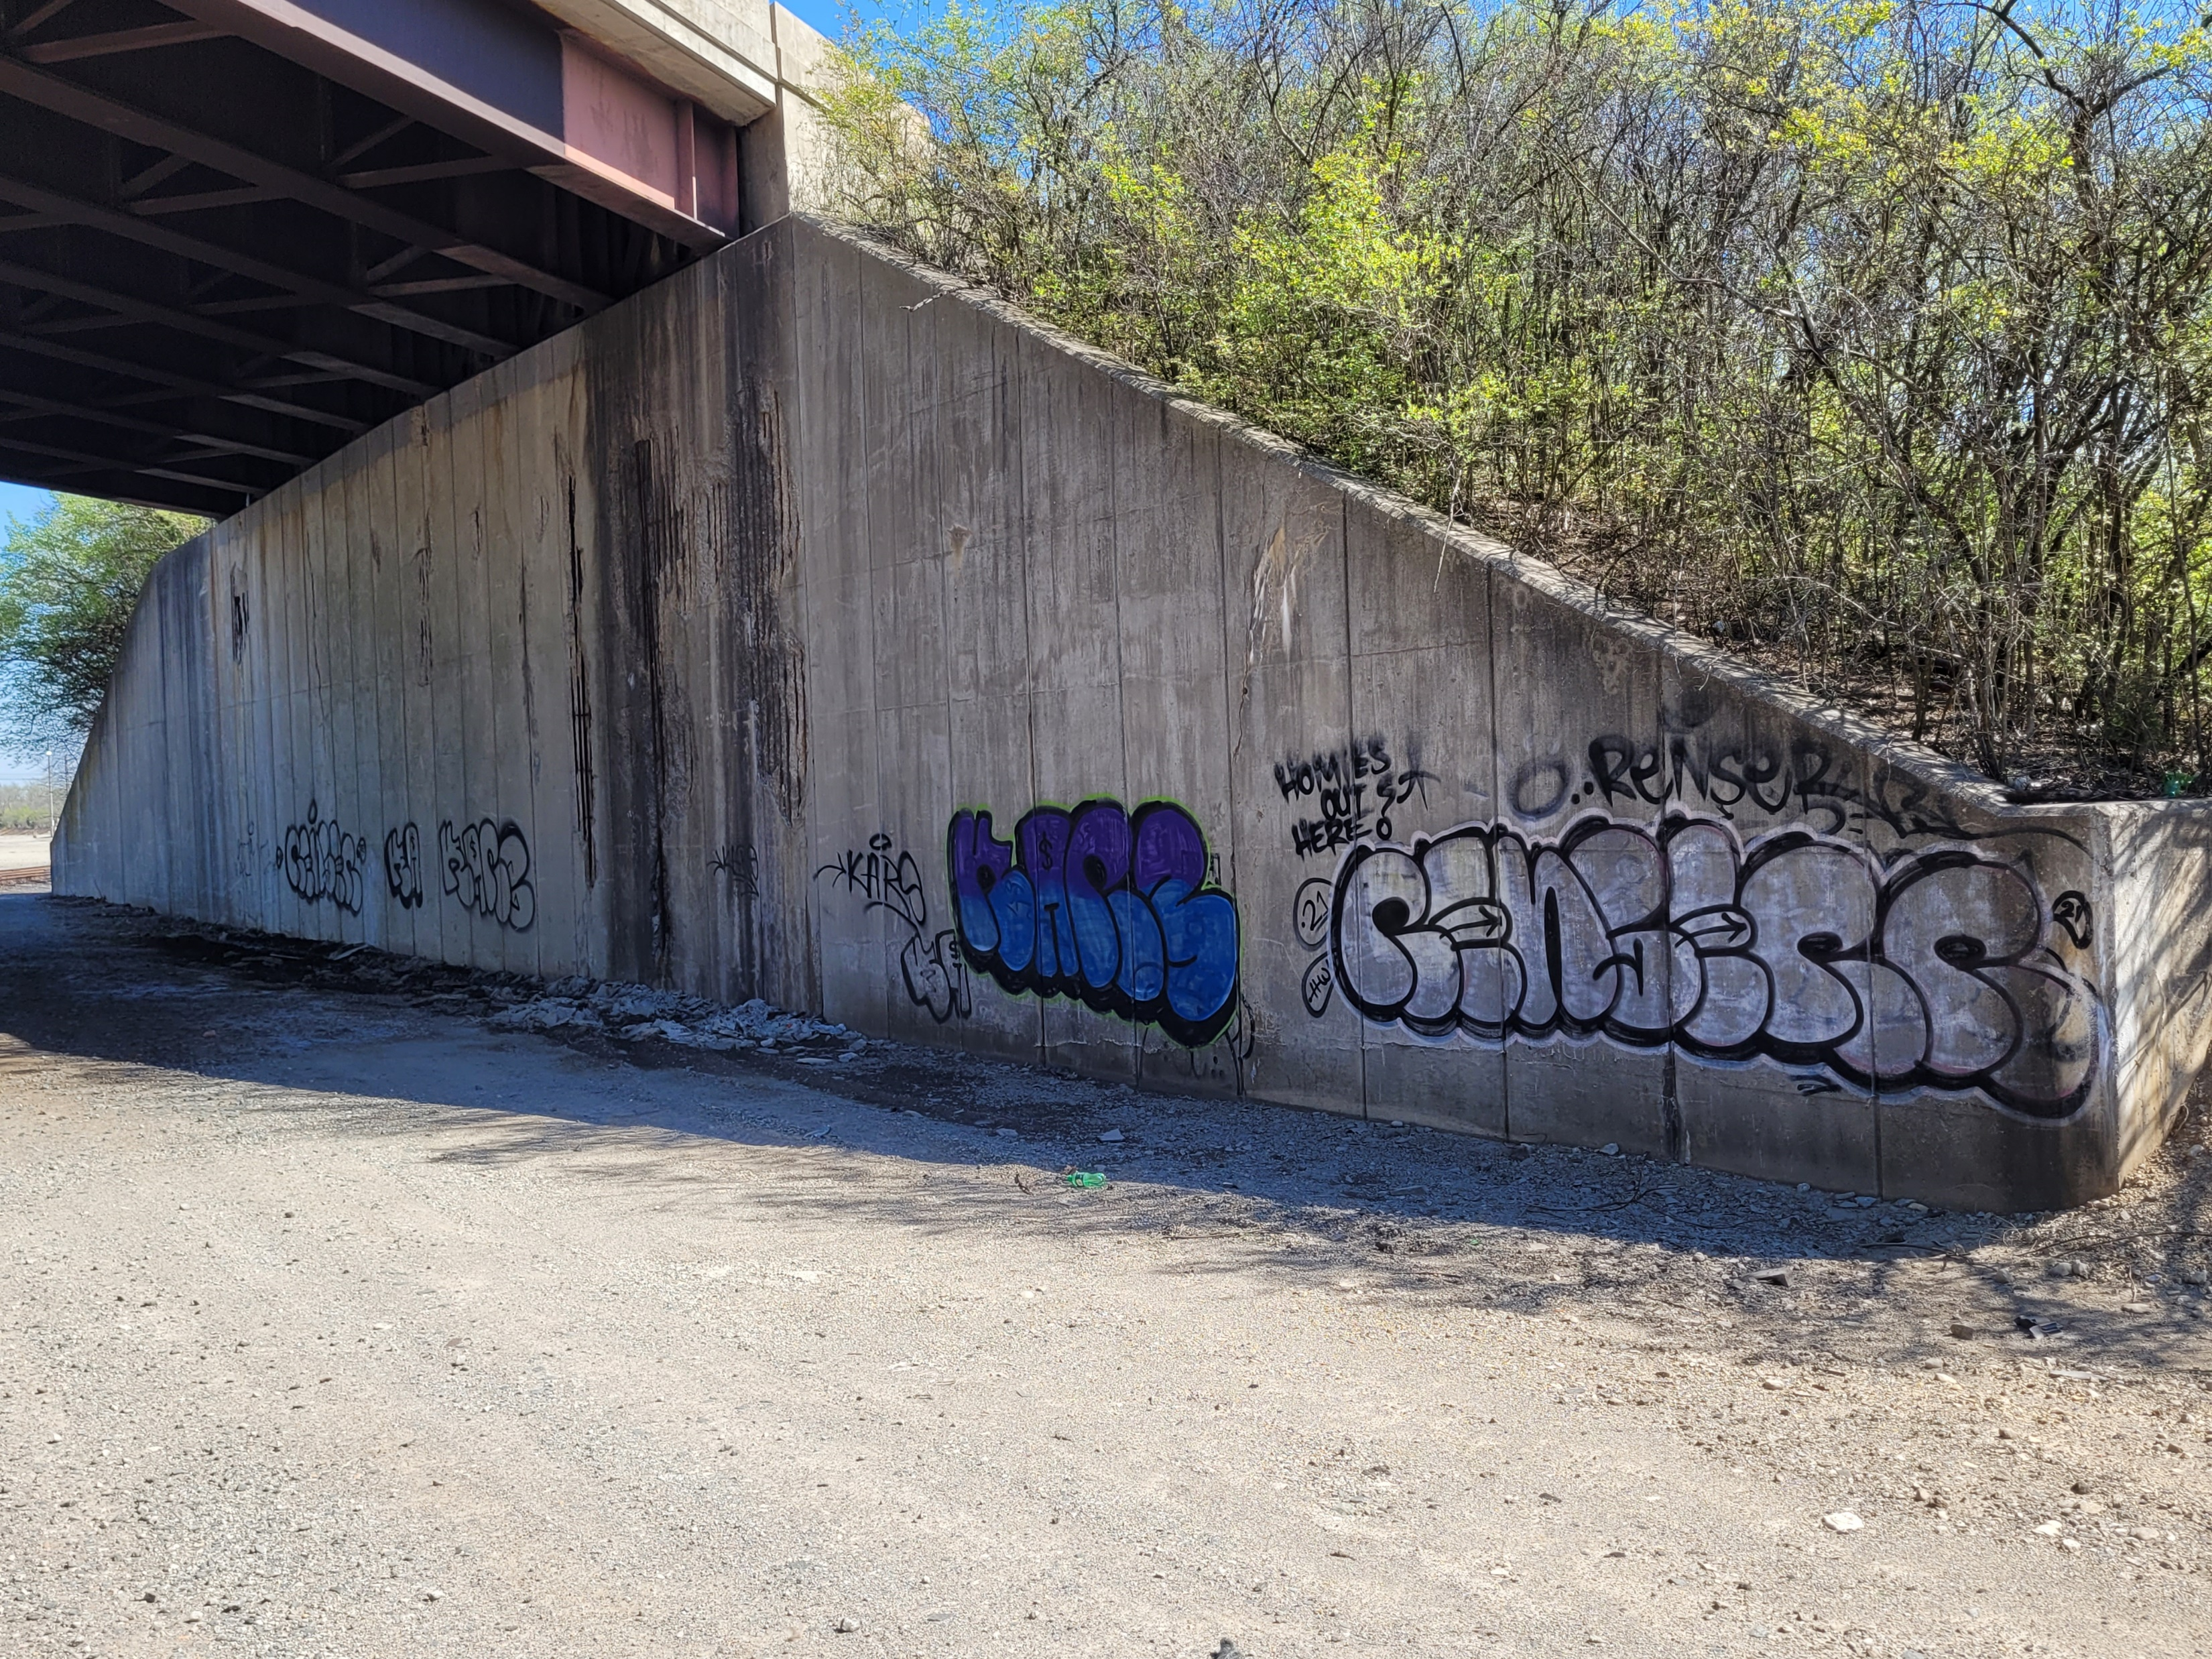
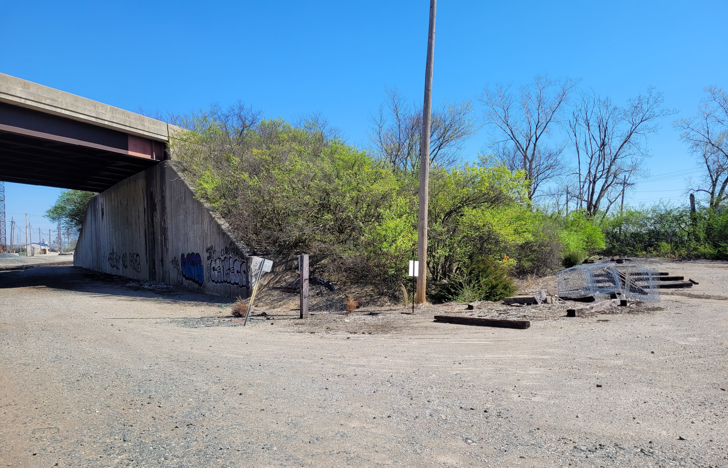
CSX Parcel

Slide 20
PROJECT COSTS
Design Engineering $250,000
Right-of-Way TBD by appraisal
Construction $1,000,000
Construction Inspection by MCEO
CSX Review and Force Account $50,000
Total Project Cost $1,300,000 + ROW

Slide 21
PROJECT SCHEDULE
Final Design Engineering: thru October 2023
Right-of-Way Acquisition: June 2023 – Nov. 2023
Advertise, Sale & Award: Nov. 2023 – Jan. 2024
Construction: 180 calendar days

Slide 22
Questions?

