Slide 2
Wenger road BRIDGE reconstruction PROJECT, clt-20-206
Notes:
Provide presentation summary verbally:
Project location
Ex structure details
Project scope
Ex condition
Right-of-way
Project costs
Project schedule
Maintenance of traffic

Slide 3
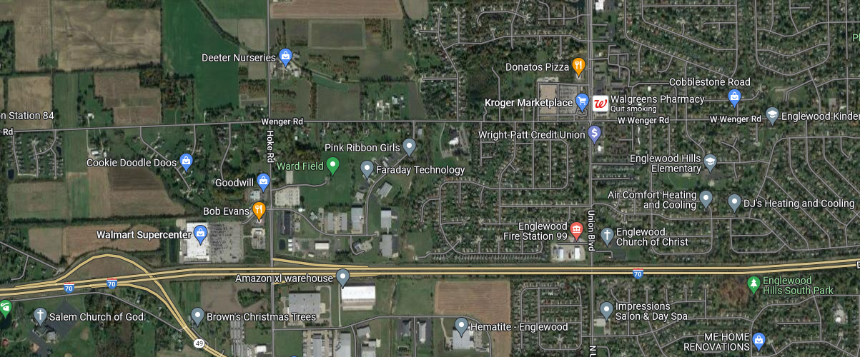
Aerial View
NORTH
PROJECT
LIMITS
WENGER RD
HOKE RD
UNION BLVD
I-70

Slide 4
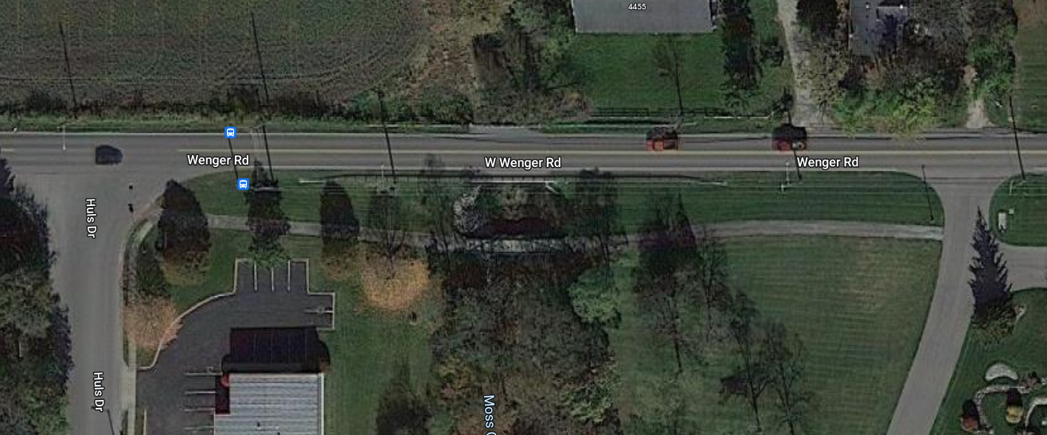
Aerial View
NORTH
CLT-20-206
PEDESTRIAN BRIDGE

Slide 5
Existing Structure details
Date Built: 1988 (no prior rehab)
Intersecting Feature: Moss Creek
Superstructure Type: Prestressed Concrete Box Beams
Span Length: 39 feet (single span)
Structure Width: 32 feet (two lanes of traffic)

Slide 6
PROJECT SCOPE
Superstructure replacement
Patching and sealing concrete surfaces
Rock channel protection improvement
Minimal roadway profile work
Guardrail replacement

Slide 7
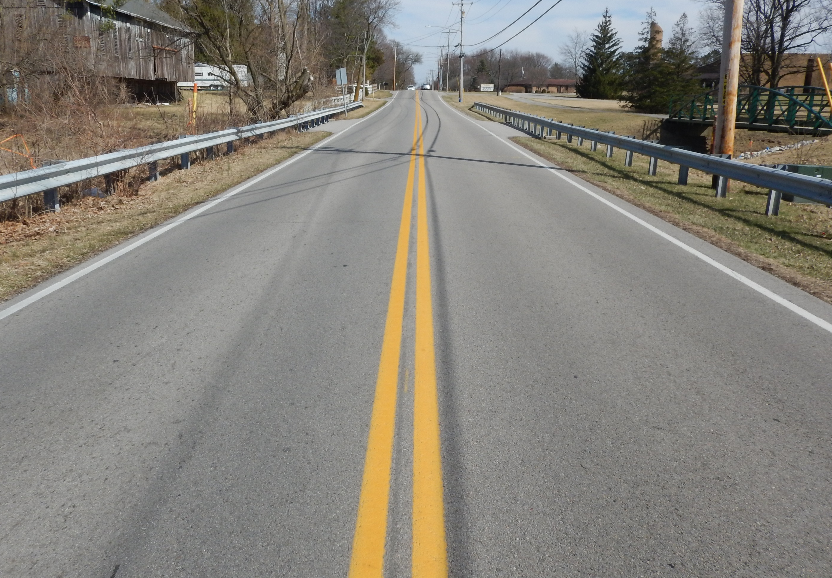
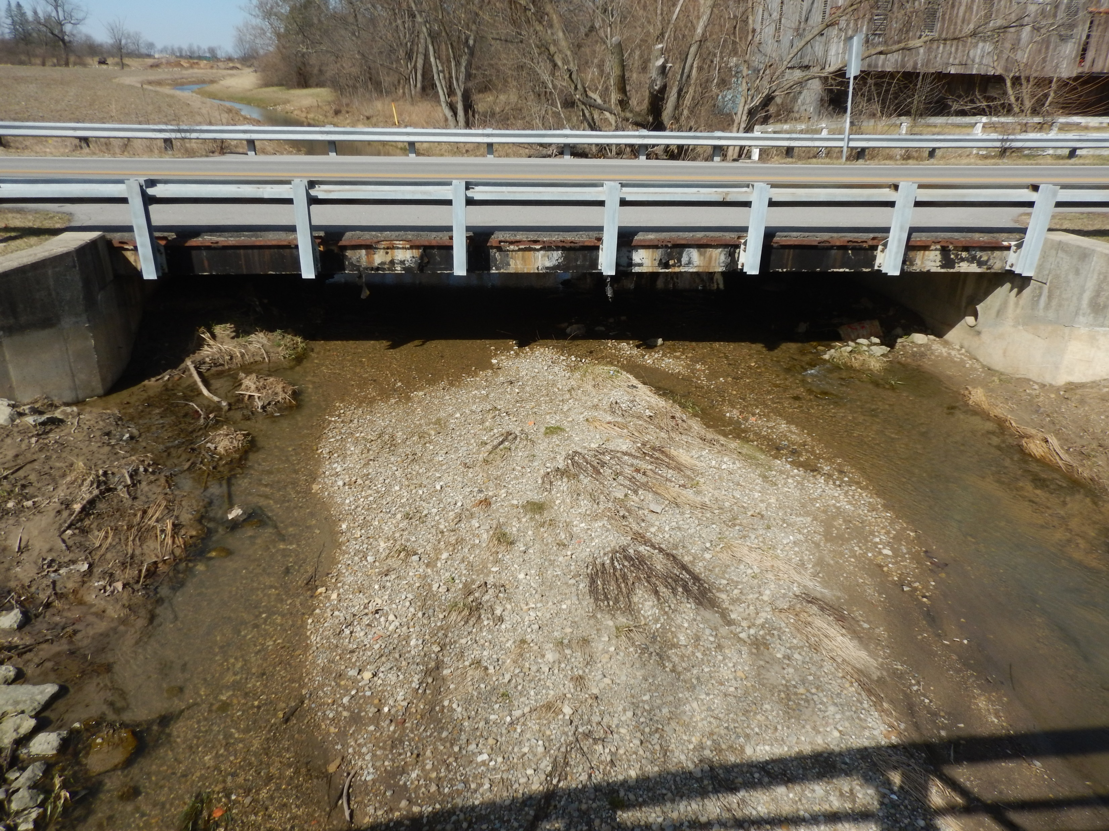
EXISTING CONDITION
On the roadway looking East over the bridge
Bridge profile looking North

Slide 8
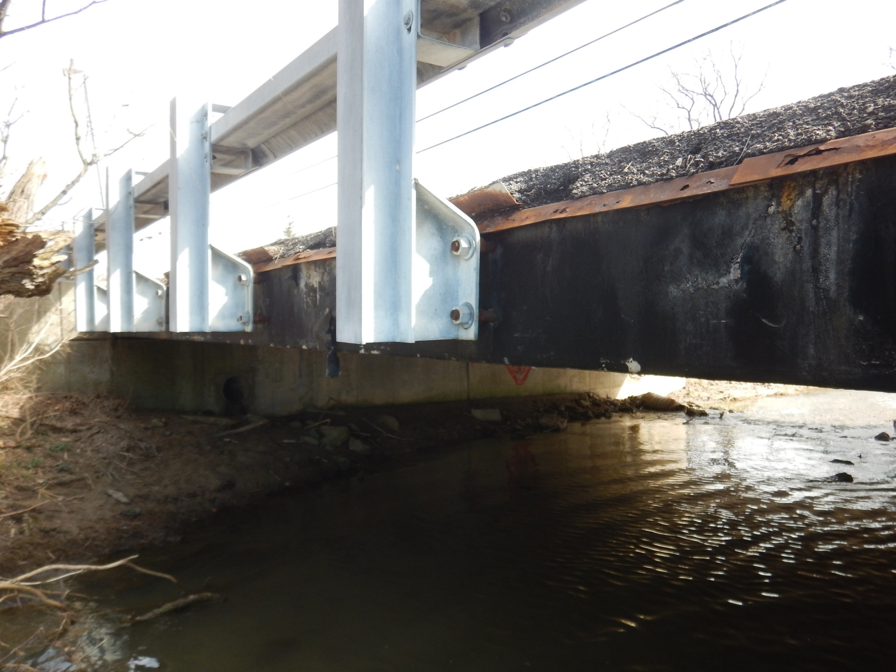
EXISTING CONDITION
The over-the-side deck drainage along both the South and North edges has deteriorated significantly. The drip edge is rusted and perforated along the whole length for both sides and the waterproofing membrane is falling off or completely missing along most of the Southern edge. This condition will be resolved with the proposed superstructure replacement.

Slide 9
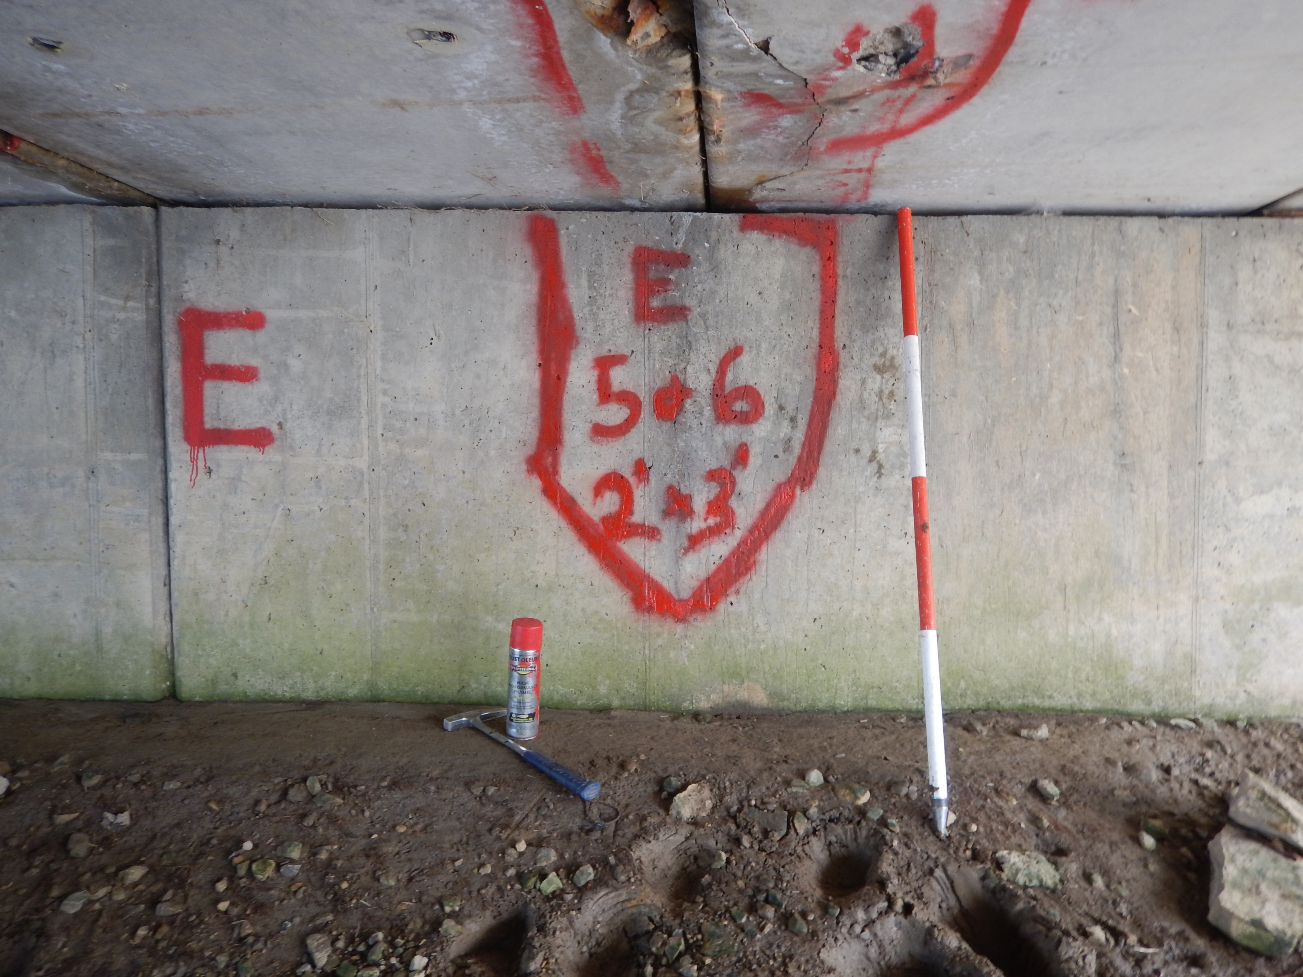
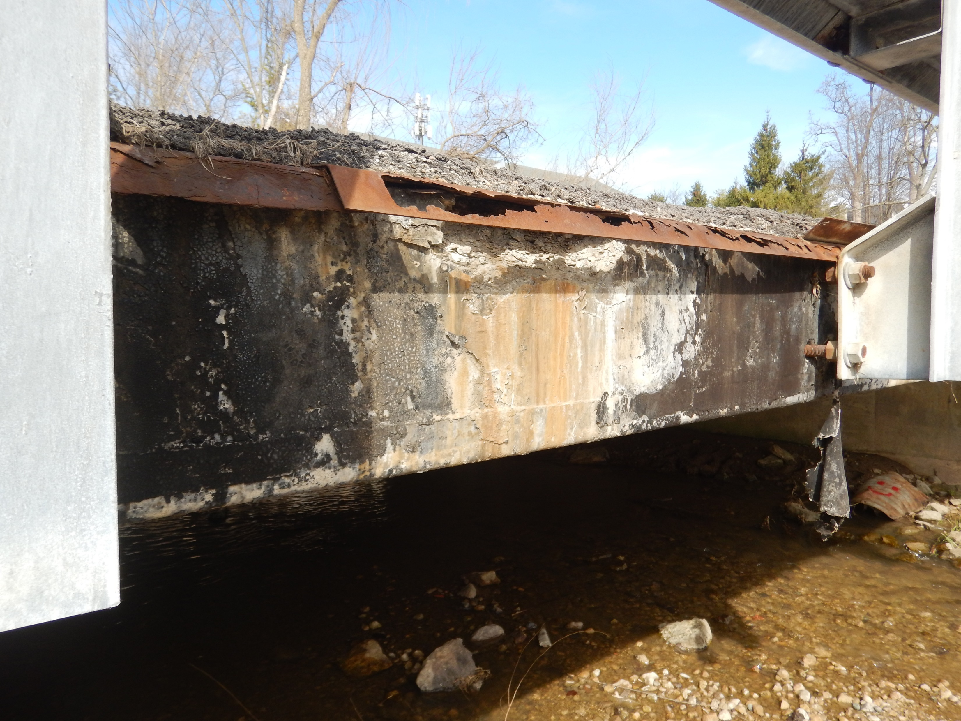
EXISTING CONDITION
Large areas of delamination on the walls of both the East and West Abutments will be removed and patched as part of the proposed project.

Slide 10
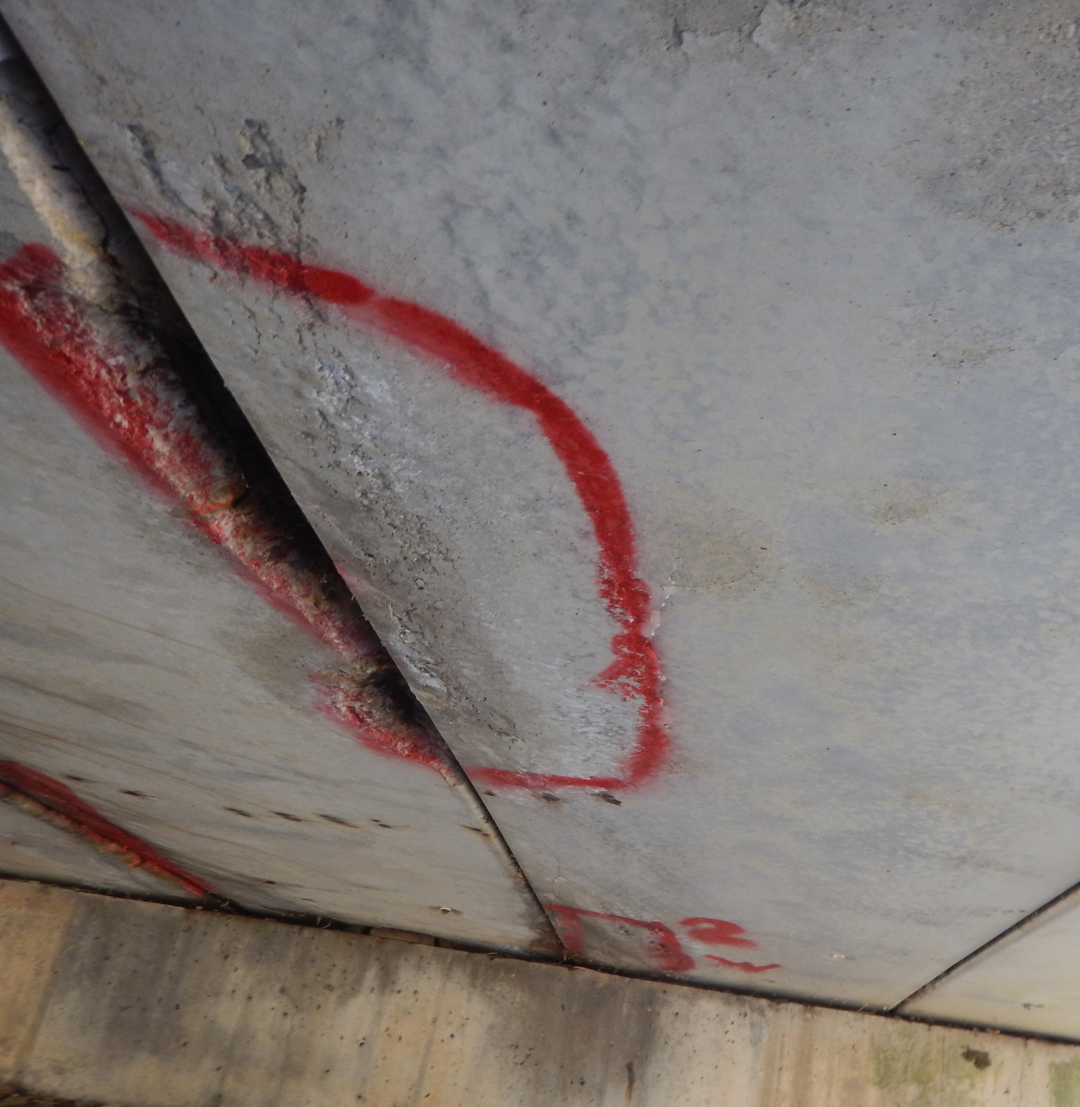
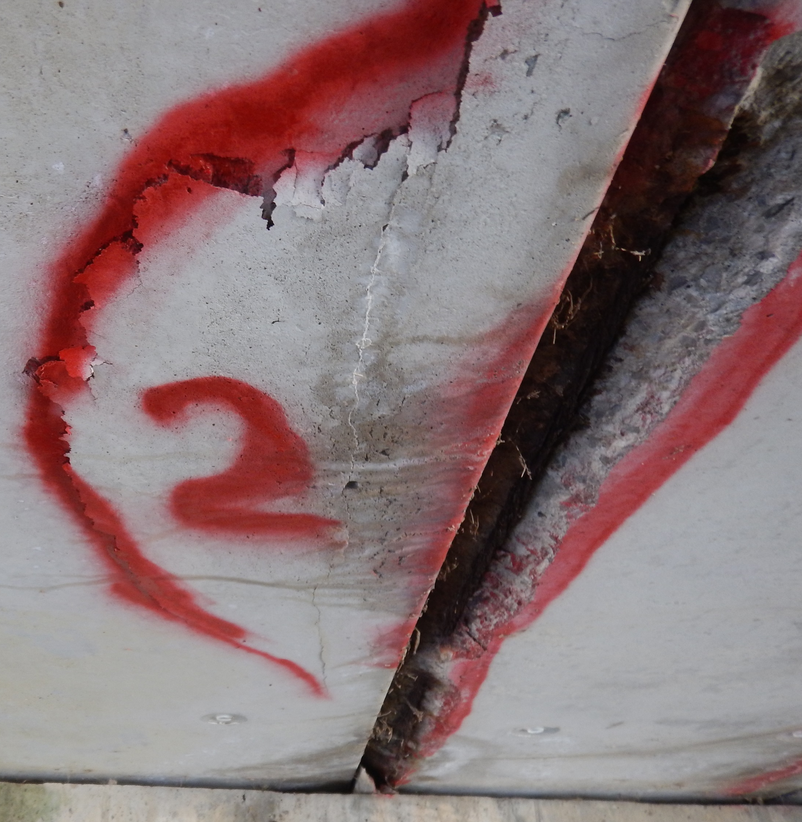
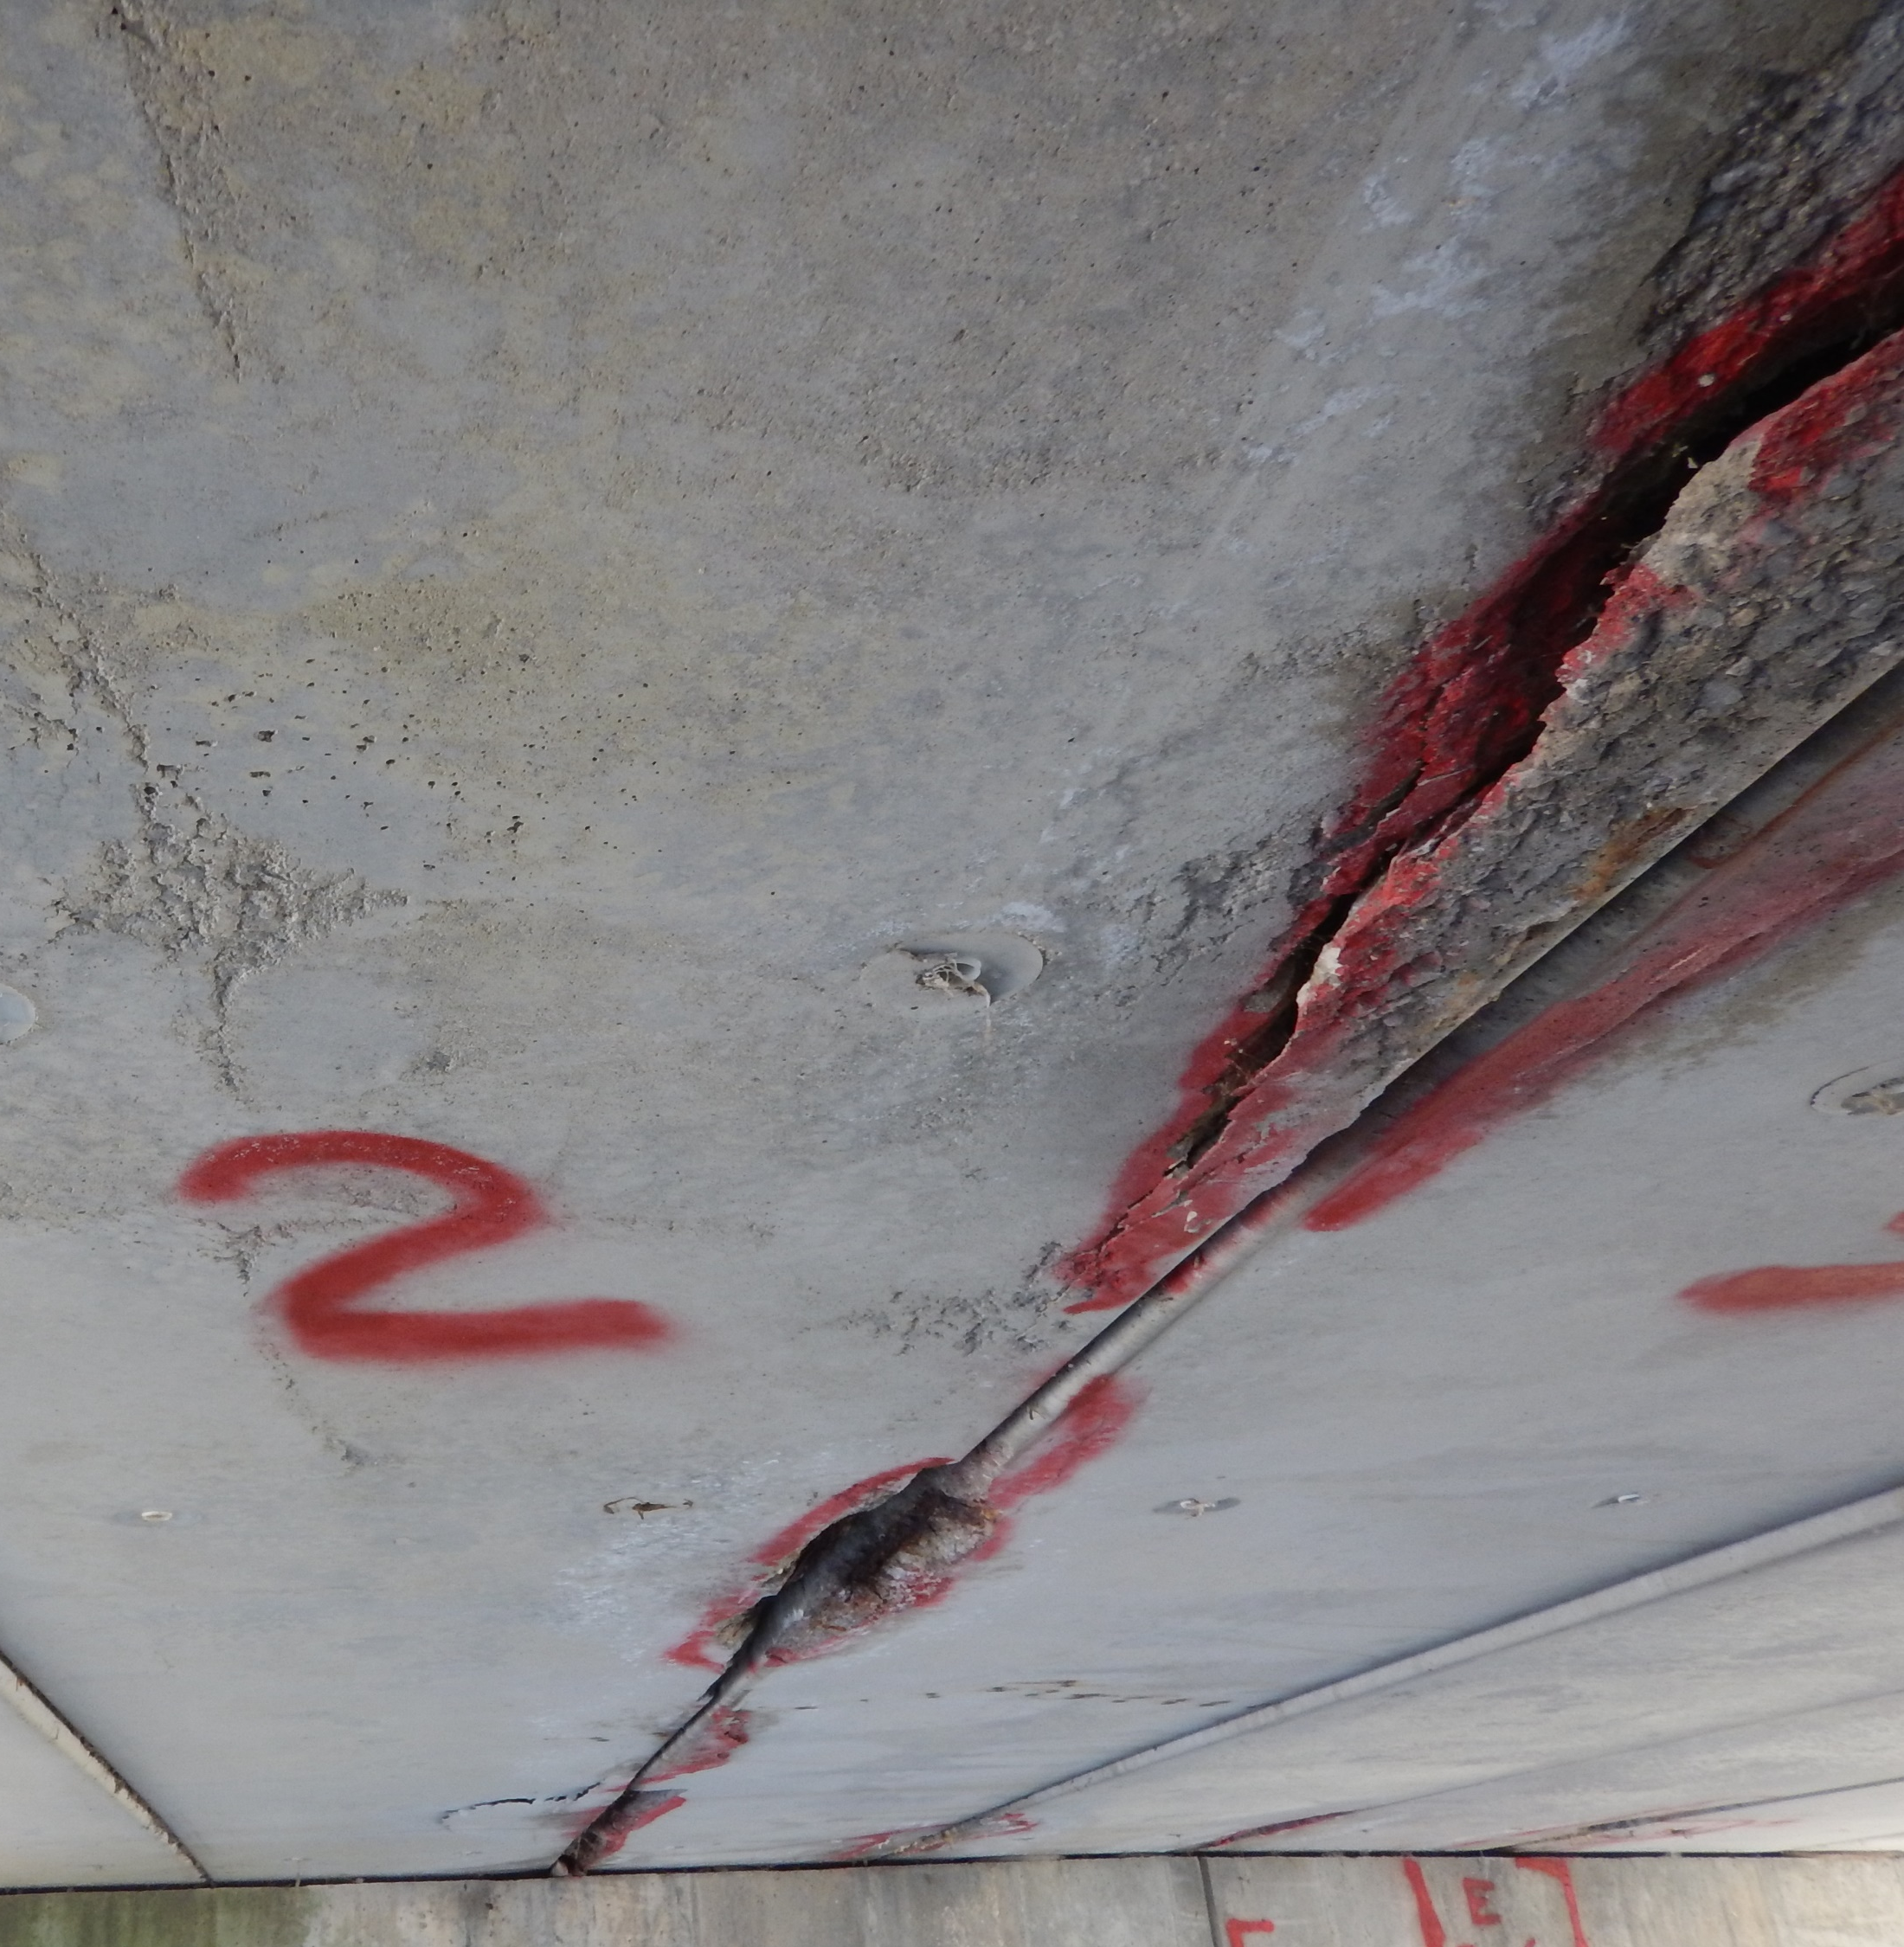
EXISTING CONDITION
Of the 8 total beams, beam #2 is in the worst condition with over 16 sqft of combined spalling, delamination, and exposed strands. Overall, the deck and superstructure were rated in Poor Condition and will be removed and replaced as part of this project.

Slide 11
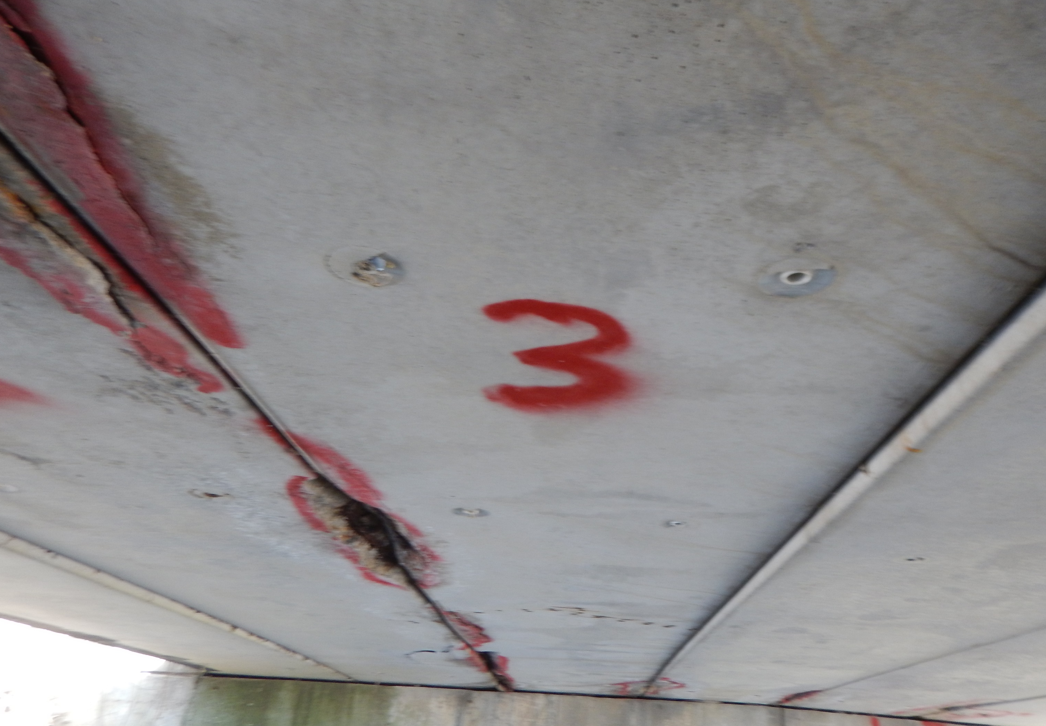
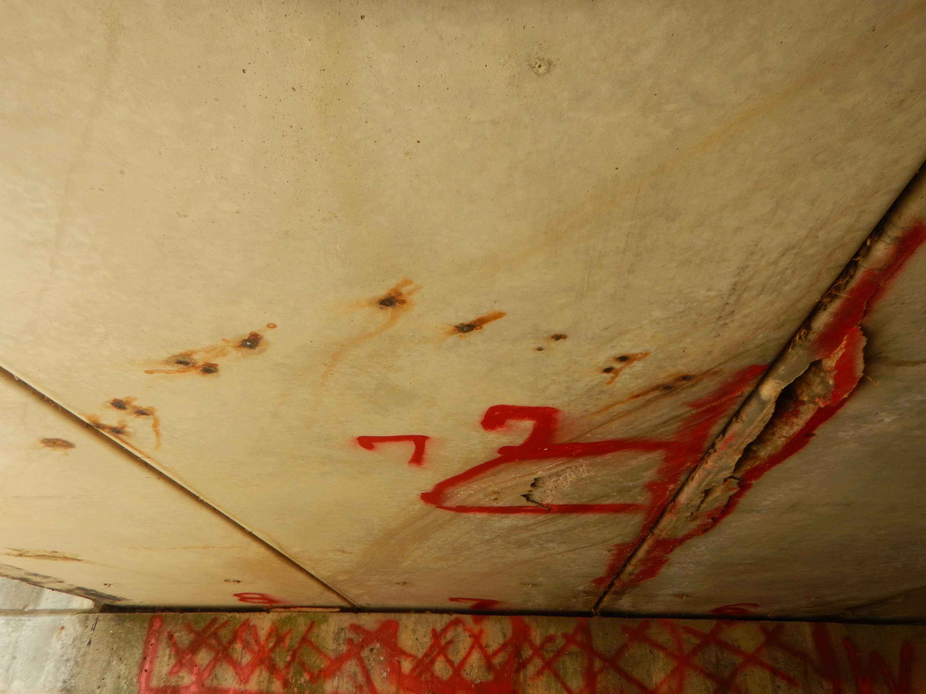
EXISTING CONDITION
Deterioration of nearby beam #3
Delamination and spalling of beams #6 & 7

Slide 12
ADJACENT PROPERTIES & RESPECTIVE OWNERS
LEGEND
NORTH
Temporary R/W
Utility Easement
No R/W Impact

Slide 13
TEMPORARY RIGHT-OF-WAY
PARCEL #2 – M57-00721-0002 – deeter et al.
NORTH
Acquisition of 0.021 acres of Temporary Easement from Parcel 2 on the north-west side of the road is necessary for access to the bridge for construction.

Slide 14
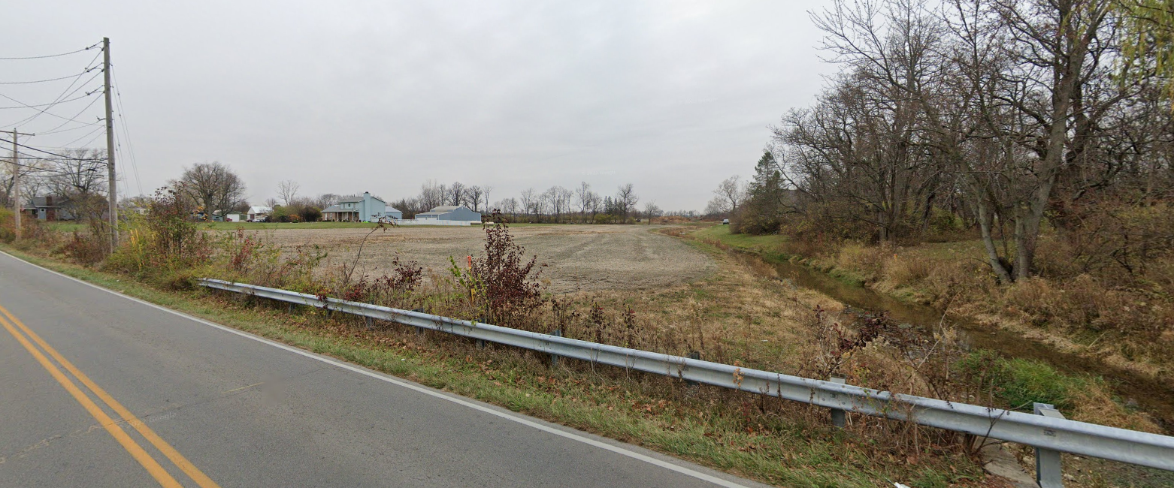
TEMPORARY RIGHT-OF-WAY
PARCEL #2 – M57-00721-0002 – deeter et al.

Slide 15
UTILITY easement
PARCEL #5 – M57-00714-0004 – St. paul catholic church
NORTH
Acquisition of 0.038 acres of Utility Easement from Parcel 5 on the south-east side of the road is necessary for AES utility deconfliction within the construction limits.

Slide 16
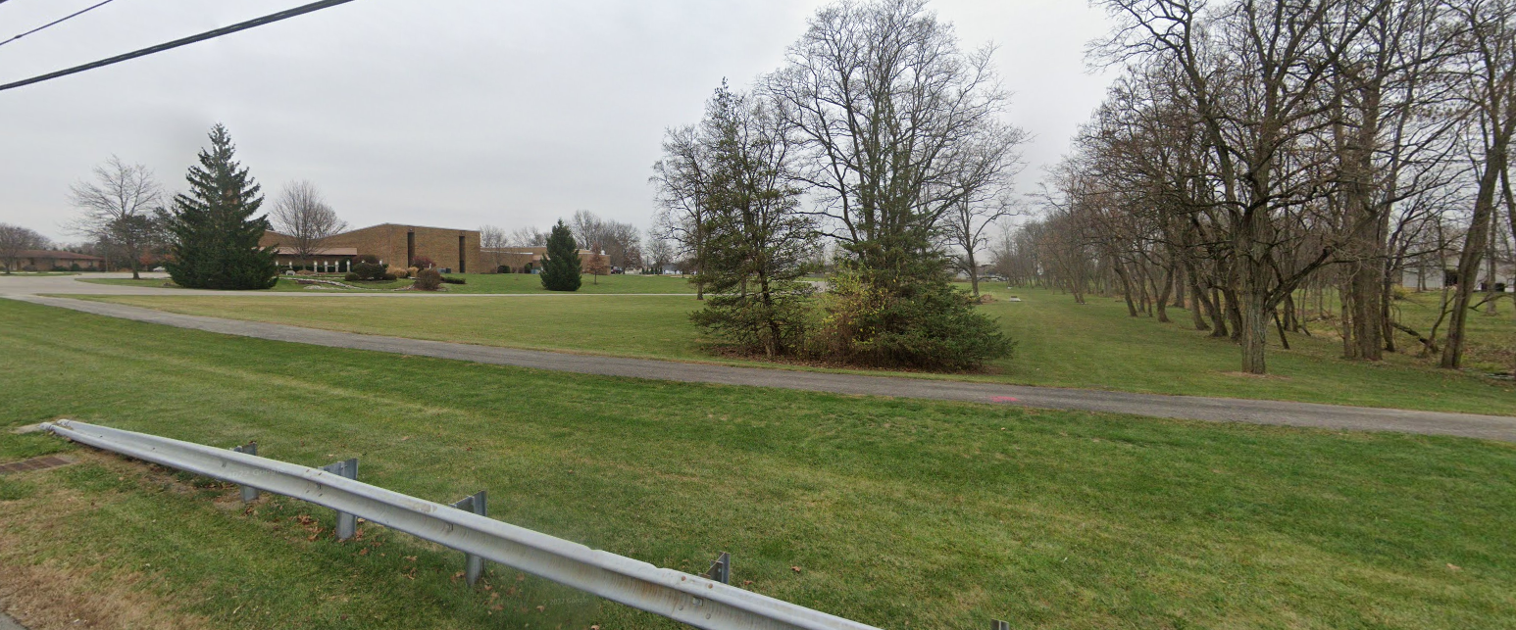
UTILITY easement
PARCEL #5 – M57-00714-0004 – St. paul catholic church

Slide 17
PROJECT COSTS
Design: MCEO design in-house
Right-of-Way: TBD by real estate appraisal
Construction:
$ 389,800.00
The MCEO has obtained an LTIP grant through the OPWC for $195,000.00 to be applied to eligible project costs

Slide 18
PROJECT SCHEDULE
Design: April 2021 – May 2023
Right-of-Way: July 2023 – December 2023
Advertise & Award: January 2024 – February 2024
Construction: March 2024 – May 2024

Slide 19
Maintenance of traffic
NORTH
Road closure for 30 working days March 2024 - May 2024
Notice sign will be in place 21 days in advance to closure
Huls Drive will be accessible from the West
Deeter Drive and St. Paul Church will be accessible from the East

